Slide 1


A journey across the digitalised economy: from networks to AI to advance sustainability
AK122V - Artificial Intelligence and Sustainable Development course
Francesca Larosa, Postdoc Research Fellow @FLOW and KTH Climate Action Centre

Slide 2

OUTLINE
The digital transition
The sustainability transition
The twin transition and its transformative powers
BREAK
Zoom into the AI zone: where about?
BREAK
Large Language Models: different mean, same need
Francesca Larosa, FLOW and KTH Climate Action Centre
Email: larosa@kth.se

Slide 3
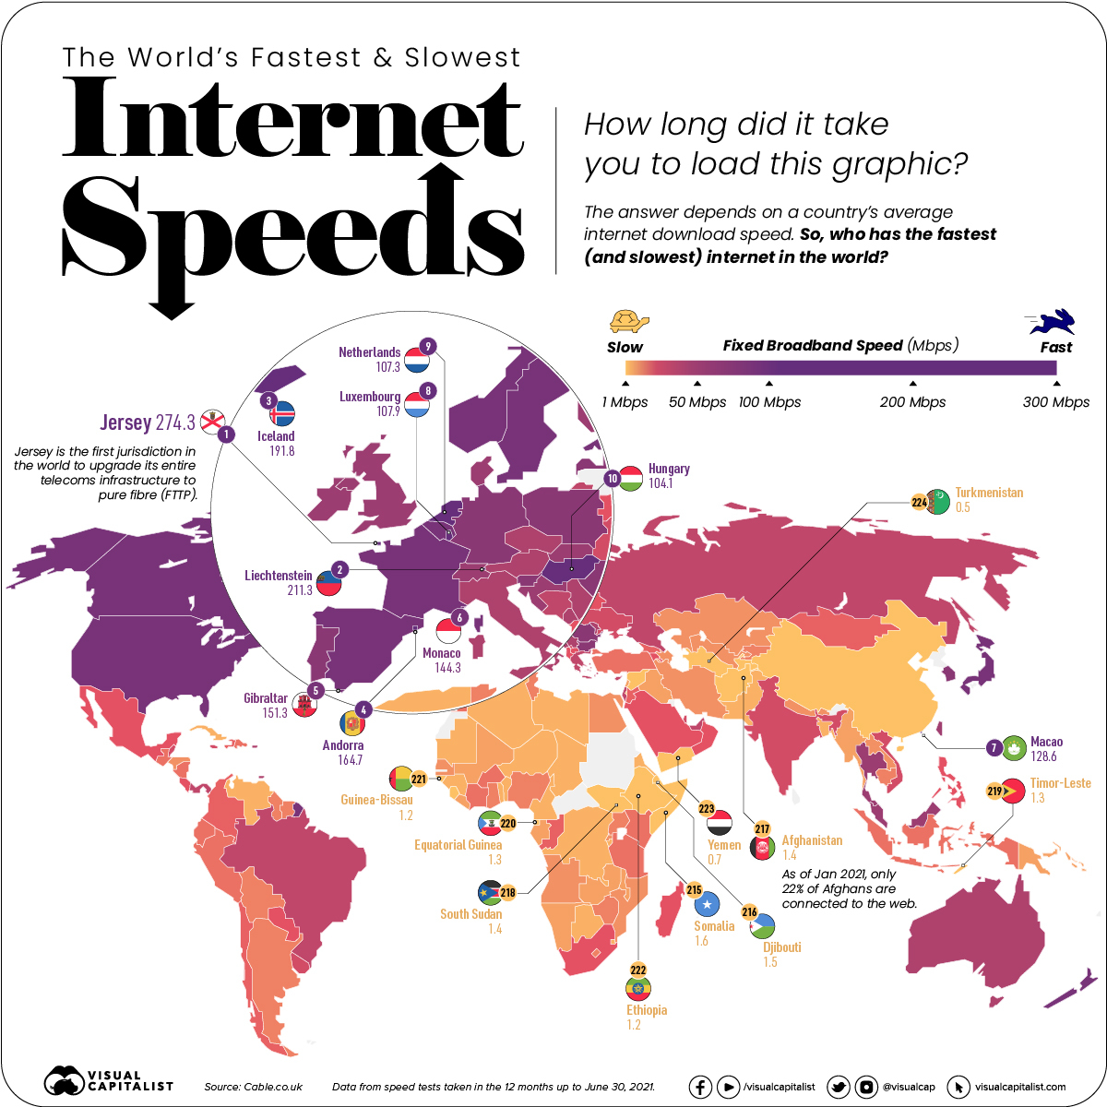
FROM DIGITAL TO DIGITALISED
Late 1980s: development of connected economy
Mass take-up of the Internet, roll-out of broadband networks
2000s: development of digital economy with increasing use of digital platforms as business models for the supply of goods and services
Currently: moving towards a digitalized economy whose production and consumption models are based on the incorporation of digital technologies in all economic, social and environmental dimensions
https://youtu.be/6dkiqJ_IZGw
Source: VisualCapitalist
Francesca Larosa, FLOW and KTH Climate Action Centre
Email: larosa@kth.se

Slide 4
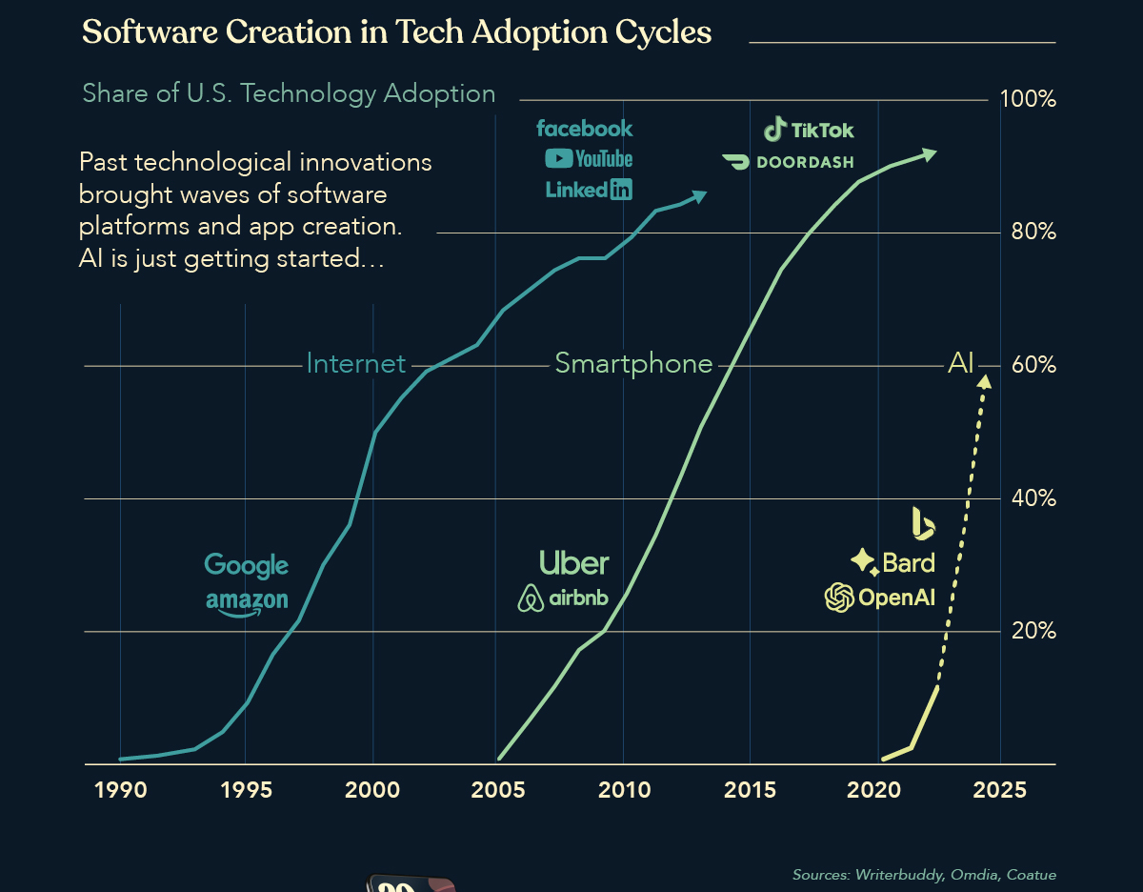
FROM DIGITAL TO DIGITALISED
Late 1980S: development of connected economy
Mass take-up of the Internet, roll-out of broadband networks
2000s: development of digital economy with increasing use of digital platforms as business models for the supply of goods and services
Currently: moving towards a digitalized economy whose production and consumption models are based on the incorporation of digital technologies in all economic, social and environmental dimensions
https://youtu.be/6dkiqJ_IZGw
Source: VisualCapitalist
Francesca Larosa, FLOW and KTH Climate Action Centre
Email: larosa@kth.se

Slide 5
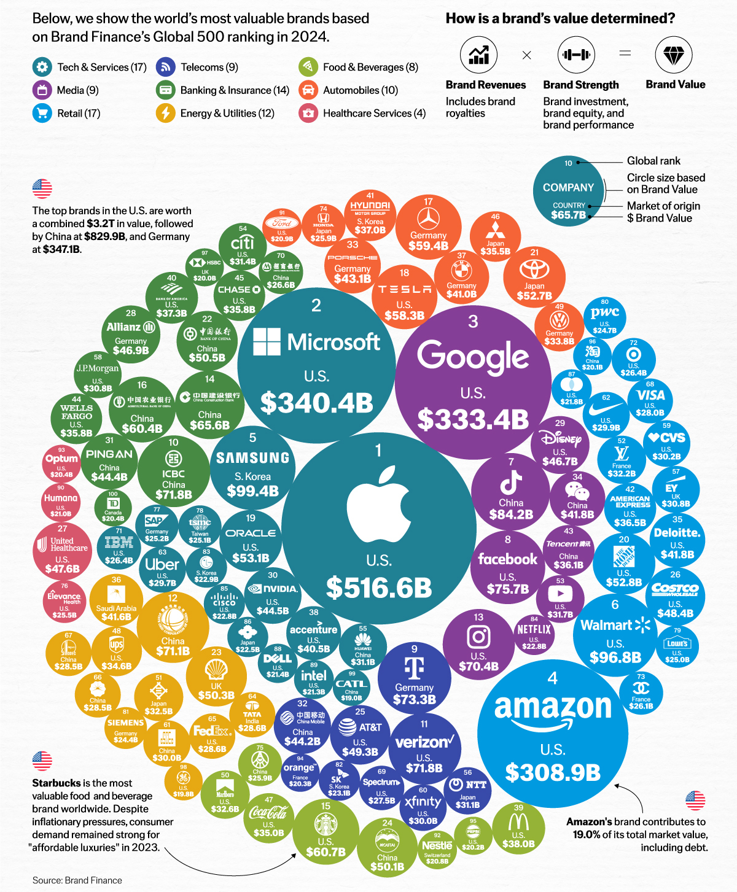
FROM DIGITAL TO DIGITALISED
Late 1980S: development of connected economy
Mass take-up of the Internet, roll-out of broadband networks
2000s: development of digital economy with increasing use of digital platforms as business models for the supply of goods and services
Currently: moving towards a digitalized economy whose production and consumption models are based on the incorporation of digital technologies in all economic, social and environmental dimensions
https://youtu.be/6dkiqJ_IZGw
Source: VisualCapitalist
Francesca Larosa, FLOW and KTH Climate Action Centre
Email: larosa@kth.se

Slide 6
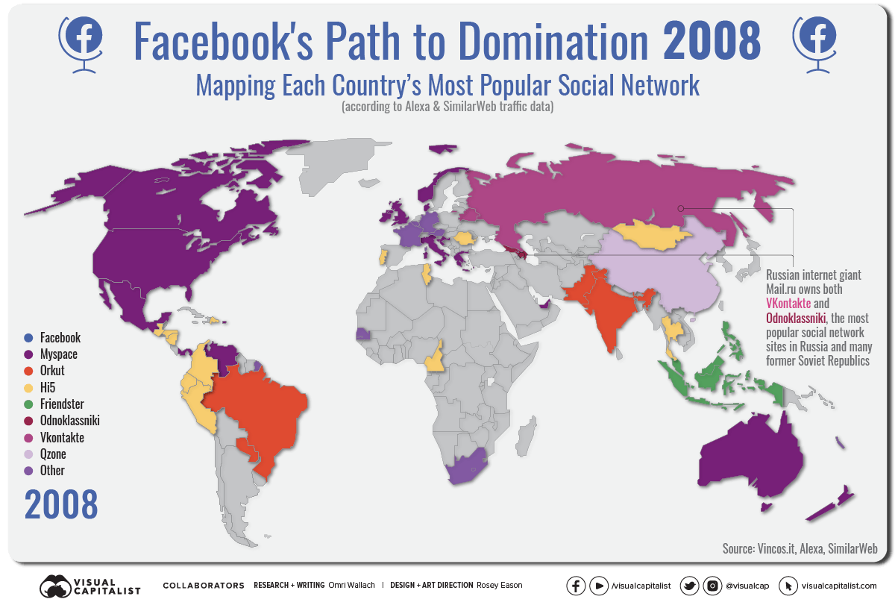
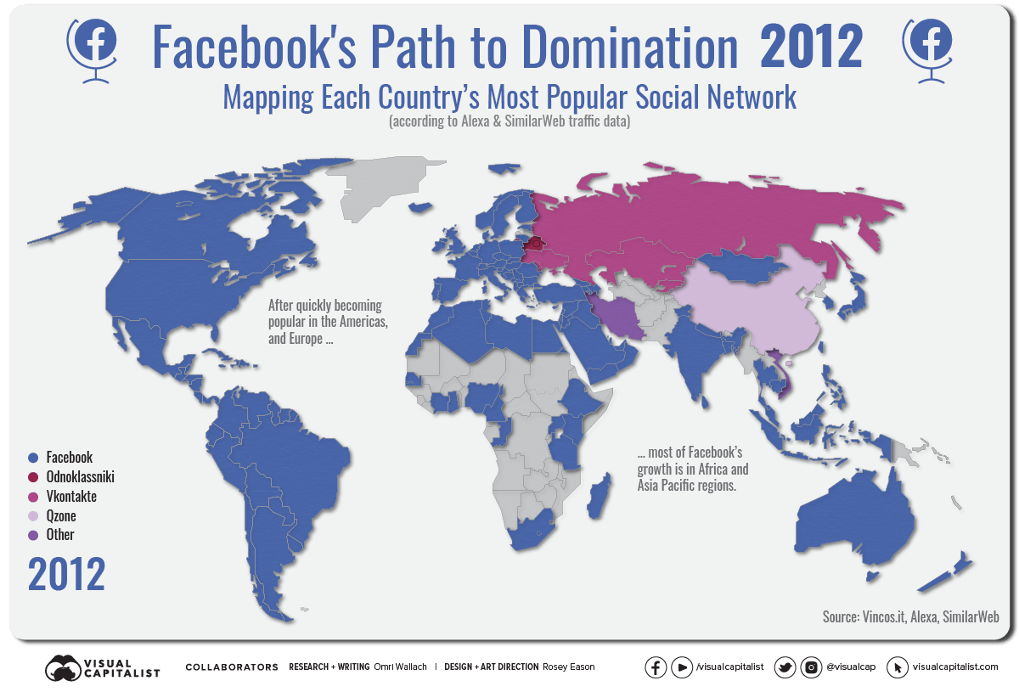
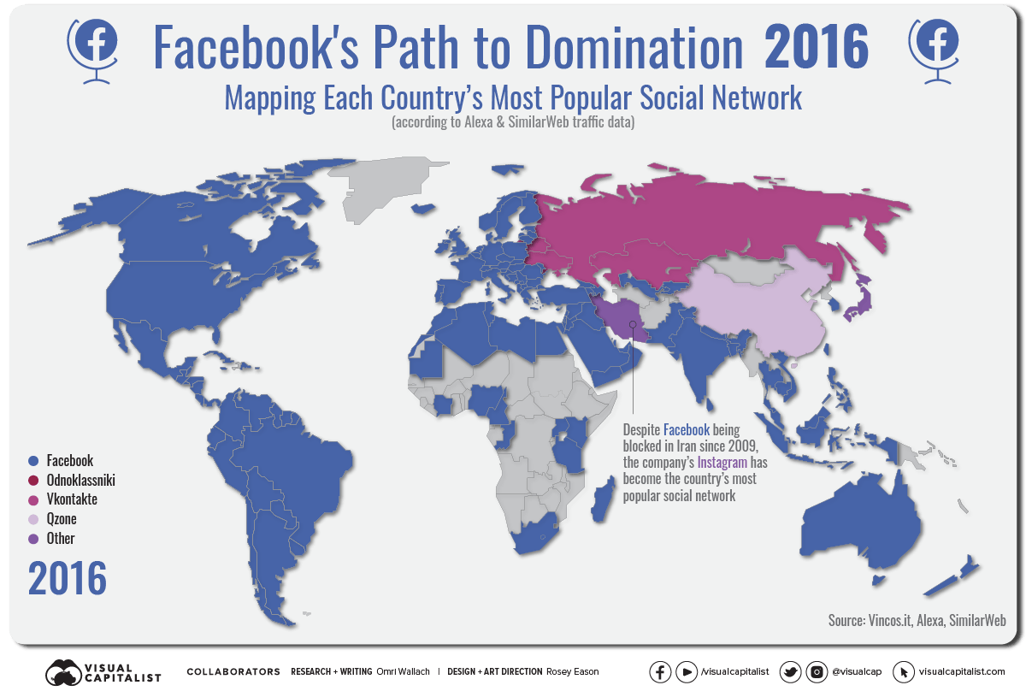
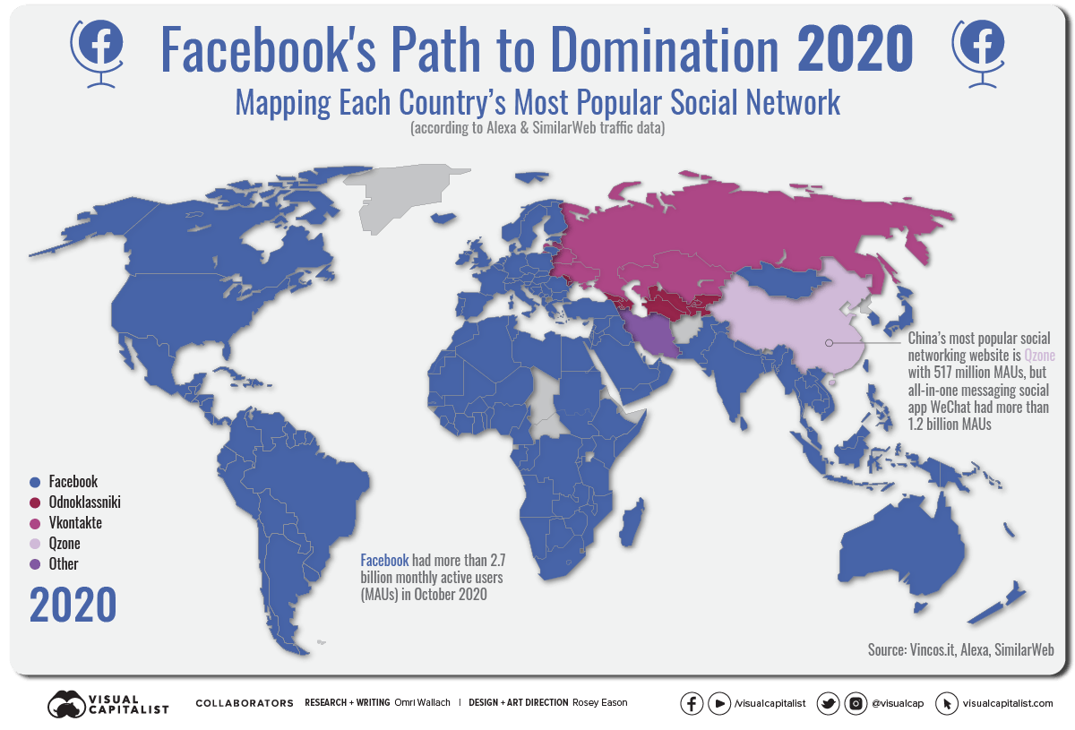
SIX DEGREES OF SEPARATION (or less?)
Francesca Larosa, FLOW and KTH Climate Action Centre
Email: larosa@kth.se

Slide 7
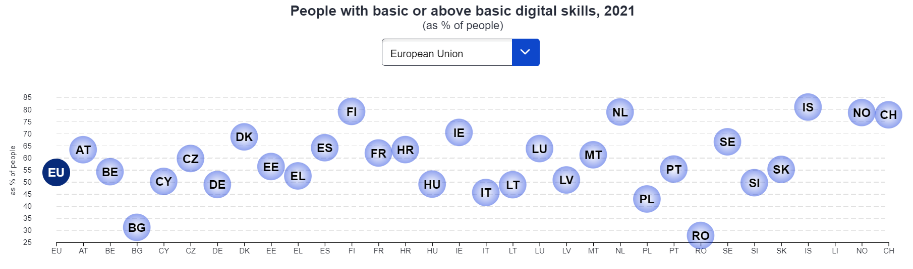
A LOOK AT THE DATA Despite this permasive transformation……
While nearly 90% of people in the EU use the internet at least once a week, only 54% had basic or above basic digital skills in 2021
Source: Eurostat
Francesca Larosa, FLOW and KTH Climate Action Centre
Email: larosa@kth.se

Slide 8
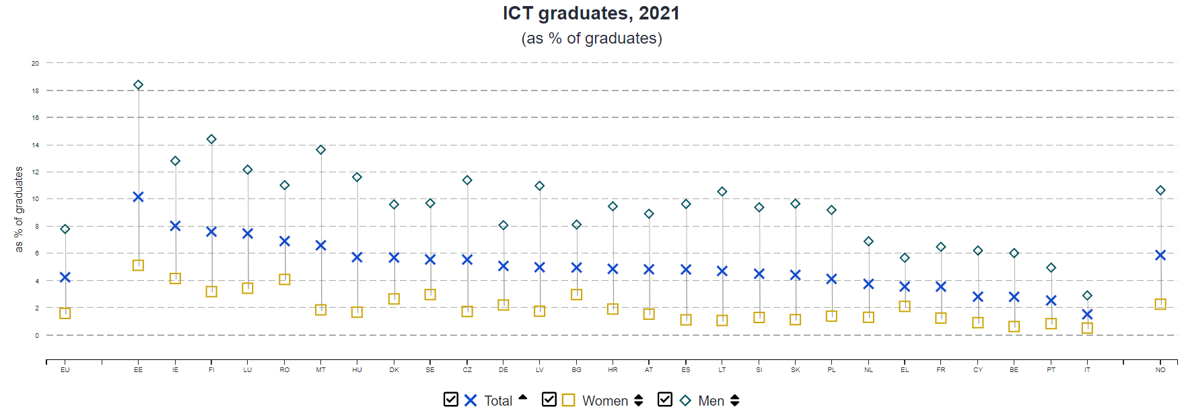
A LOOK AT THE DATA Despite this permasive transformation……
Only 4% of graduates in the EU are in the ICT field. The proportion of graduates in ICT was highest in Estonia (10%) and Ireland (8%), in contrast to 2% in Italy and 3% in Portugal, Belgium and Cyprus. ICT specialists make up nearly 5% of the EU's workforce.
Source: Eurostat
Francesca Larosa, FLOW and KTH Climate Action Centre
Email: larosa@kth.se

Slide 9
FROM DEVELOPMENT TO SUSTAINABILITY
The history of digitalization sparks from three human abilities: discover, understand and communicate (curiosity, analysis and socialization).
For thousands of years, the quickest method of sending complex messages over long distances was with a courier on horseback. The electricity came. In 1839, the world’s first commercial telegraph service opened in London with a system created by Charles Whe​atstone. In the United States, Samuel Morse used the new Morse code to send his first telegraph message in 1844. Already in 1843, a precursor of the fax ma​chine for transmitting images had been patented in the United Kingdom by Alexander Bain.​
In 1858, the first transatlantic telegraph cable was laid. But there was a problem. Where lines crossed national borders, messages had to be stopped and translated into the particular system of the next jurisdiction.To simplify matters, regional agreements began to be forged, and in Europe, representatives of 20 States gathered in Paris at an International Telegraph Conference to find ways to overcome barriers and make services more efficient.
Francesca Larosa, FLOW and KTH Climate Action Centre
Email: larosa@kth.se

Slide 10
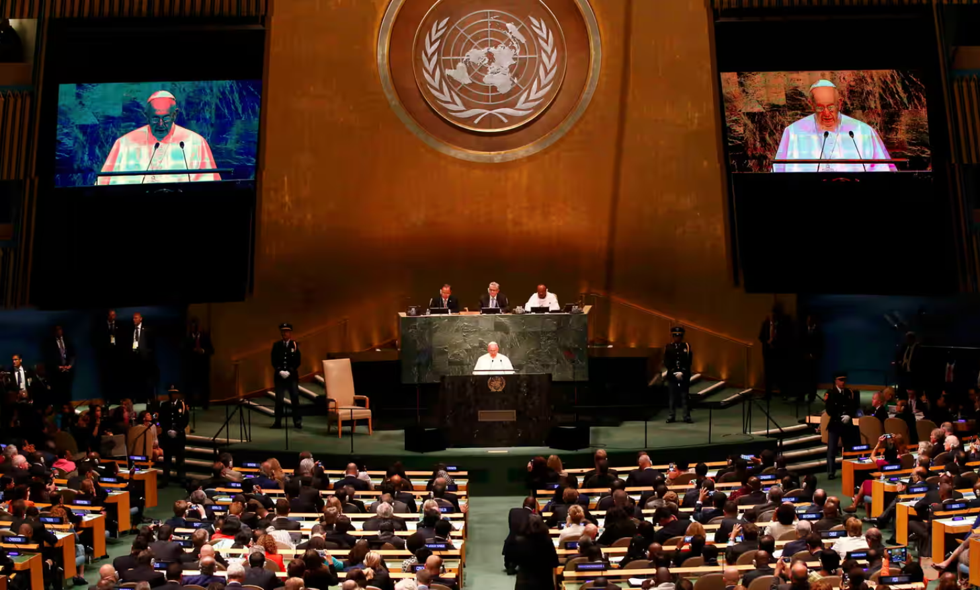
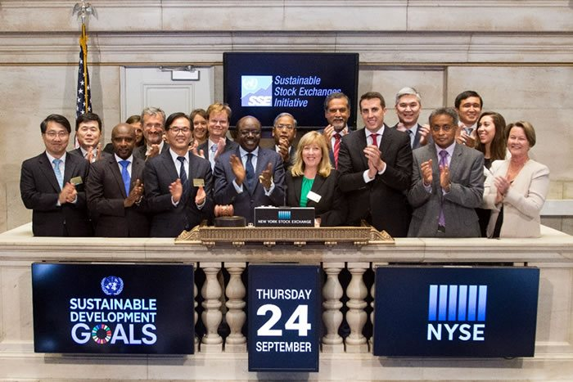
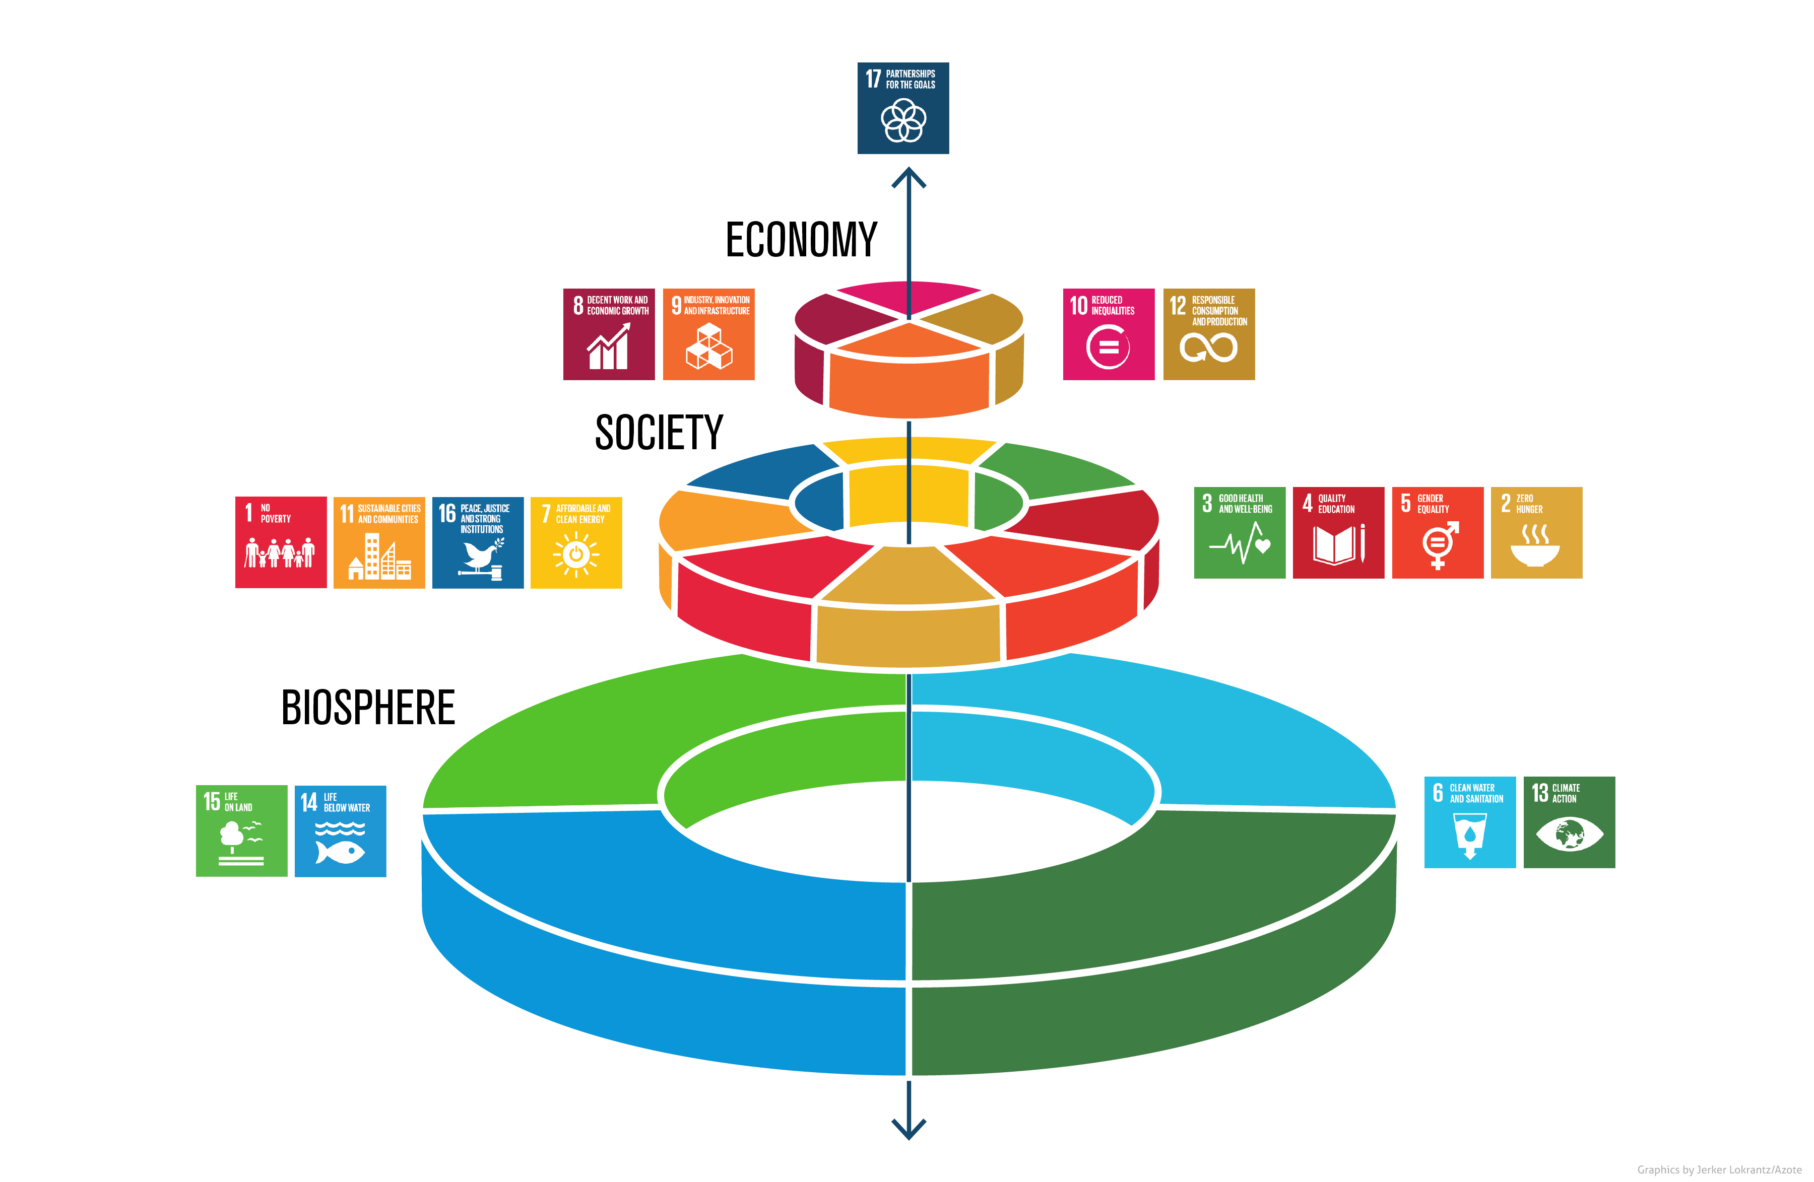
FROM DEVELOPMENT TO SUSTAINABILITY
September 25th 2015: the UN SDGs are launched in New York at the UNGA plenary session.
The UN Secretary General at that time is Ban Ki-Moon. 6.38pm CET he says:
The new agenda is a promise by leaders to all people everywhere. It is a universal, integrated and transformative vision for a better world. It is an agenda for people, to end poverty in all its forms. An agenda for the planet, our common home. An agenda for shared prosperity, peace and partnership. It conveys the urgency of climate action. It is rooted in gender equality and respect for the rights of all. Above all, it pledges to leave no one behind. The true test of commitment to Agenda 2030 will be implementation. We need action from everyone, everywhere. To achieve these new global goals, we will need your high-level political commitment. […] We can no longer afford to think and work in silos.
Francesca Larosa, FLOW and KTH Climate Action Centre
Email: larosa@kth.se

Slide 11
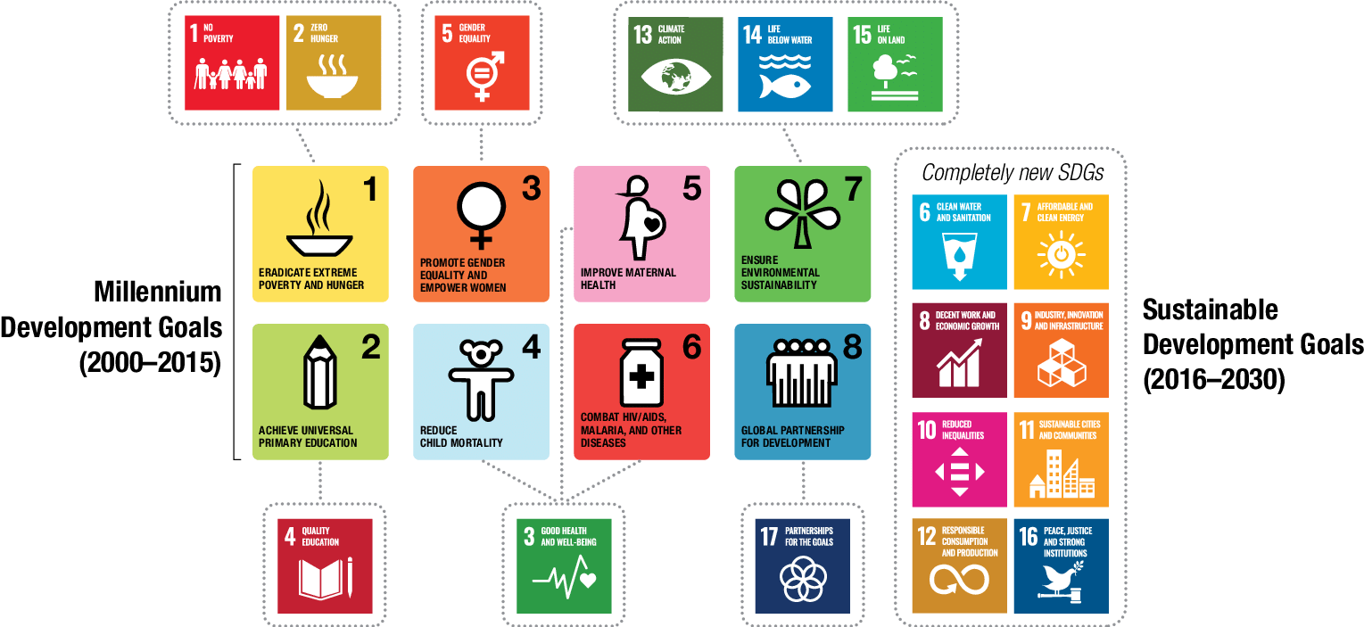
FROM DEVELOPMENT TO SUSTAINABILITY
The new agenda is derived from the Millennium Development Goals
Francesca Larosa, FLOWand KTH Climate Action Centre
Email: larosa@kth.se
Notes:
Signed by 189 countries in 2000, the MDGs were a framework of 8 goals, 18 targets and 48 indicators. Substantial progress has been made regarding the MDGs. The world has already realized the first MDG of halving the extreme poverty rate by 2015.

Slide 12
FROM DEVELOPMENT TO SUSTAINABILITY
And the ICT?
Target 8.F: In cooperation with the private sector, make available the benefits of new technologies, especially information and communications
Indicators 8.14 Fixed telephone lines per 100 population 8.15 Mobile cellular subscriptions per 100 population 8.16 Internet users per 100 population
Francesca Larosa, FLOW and KTH Climate Action Centre
Email: larosa@kth.se

Slide 13
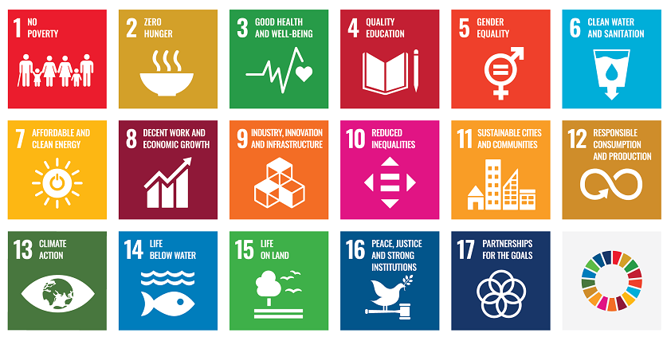

THE SDGS: WHERE DOES TECHNOLOGY ENTER THIS PICTURE?
Access the QR Code or go to https://www.menti.com/alch4jrdtu2w !
Francesca Larosa, FLOW and KTH Climate Action Centre
Email: larosa@kth.se

Slide 14
THE SDGS: WHERE DOES TECHNOLOGY ENTER THIS PICTURE?
2.a Increase investment, including through enhanced international cooperation, in rural infrastructure, agricultural research and extension services, technology development and plant and livestock gene banks in order to enhance agricultural productive capacity in developing countries, in particular least developed countries
1.4 By 2030, ensure that all men and women, in particular the poor and the vulnerable, have equal rights to economic resources, as well as access to basic services, ownership and control over land and other forms of property, inheritance, natural resources, appropriate new technology and financial services, including microfinance
Francesca Larosa, FLOW and KTH Climate Action Centre
Email: larosa@kth.se

Slide 15
THE SDGS: WHERE DOES TECHNOLOGY ENTER THIS PICTURE?
4.4.1 Proportion of youth and adults with information and communications technology (ICT) skills, by type of skill
4.b By 2020, substantially expand globally the number of scholarships available to developing countries, in particular least developed countries, small island developing States and African countries, for enrolment in higher education, including vocational training and information and communications technology, technical, engineering and scientific programmes, in developed countries and other developing countries
5.b Enhance the use of enabling technology, in particular information and communications technology, to promote the empowerment of women
Francesca Larosa, FLOW and KTH Climate Action Centre
Email: larosa@kth.se

Slide 16
THE SDGS: WHERE DOES TECHNOLOGY ENTER THIS PICTURE?
7.1.2 Proportion of population with primary reliance on clean fuels and technology
7.a By 2030, enhance international cooperation to facilitate access to clean energy research and technology, including renewable energy, energy efficiency and advanced and cleaner fossil-fuel technology, and promote investment in energy infrastructure and clean energy technology
7.b By 2030, expand infrastructure and upgrade technology for supplying modern and sustainable energy services for all in developing countries, in particular least developed countries, small island developing States and landlocked developing countries, in accordance with their respective programmes of support
7.b.1 Investments in energy efficiency as a percentage of GDP and the amount of foreign direct investment in financial transfer for infrastructure and technology to sustainable development services
Francesca Larosa, FLOW and KTH Climate Action Centre
Email: larosa@kth.se

Slide 17
THE SDGS: WHERE DOES TECHNOLOGY ENTER THIS PICTURE?
9.b Support domestic technology development, research and innovation in developing countries, including by ensuring a conducive policy environment for, inter alia, industrial diversification and value addition to commodities
9.c Significantly increase access to information and communications technology and strive to provide universal and affordable access to the Internet in least developed countries by 2020
9.c.1 Proportion of population covered by a mobile network, by technology
Francesca Larosa, FLOW and KTH Climate Action Centre
Email: larosa@kth.se

Slide 18
THE SDGS: WHERE DOES TECHNOLOGY ENTER THIS PICTURE?
13.3.2 Number of countries that have communicated the strengthening of institutional, systemic and individual capacity-building to implement adaptation, mitigation and technology transfer, and development actions
13.b.1 Number of least developed countries and small island developing States that are receiving specialized support, and amount of support, including finance, technology and capacity-building, for mechanisms for raising capacities for effective climate change-related planning and management, including focusing on women, youth and local and marginalized communities
Francesca Larosa, FLOW and KTH Climate Action Centre
Email: larosa@kth.se

Slide 19
THE SDGS: WHERE DOES TECHNOLOGY ENTER THIS PICTURE?
14.a Increase scientific knowledge, develop research capacity and transfer marine technology, taking into account the Intergovernmental Oceanographic Commission Criteria and Guidelines on the Transfer of Marine Technology, in order to improve ocean health and to enhance the contribution of marine biodiversity to the development of developing countries, in particular small island developing States and least developed countries
14.a.1 Proportion of total research budget allocated to research in the field of marine technology
Francesca Larosa, FLOW and KTH Climate Action Centre
Email: larosa@kth.se

Slide 20
THE SDGS: WHERE DOES TECHNOLOGY ENTER THIS PICTURE?
Technology
17.6 Enhance North-South, South-South and triangular regional and international cooperation on and access to science, technology and innovation and enhance knowledge-sharing on mutually agreed terms, including through improved coordination among existing mechanisms, in particular at the United Nations level, and through a global technology facilitation mechanism
17.6.1 Number of science and/or technology cooperation agreements and programmes between countries, by type of cooperation
17.6.2 Fixed Internet broadband subscriptions per 100 inhabitants, by speed
17.7 Promote the development, transfer, dissemination and diffusion of environmentally sound technologies to developing countries on favourable terms, including on concessional and preferential terms, as mutually agreed
17.7.1 Total amount of approved funding for developing countries to promote the development, transfer, dissemination and diffusion of environmentally sound technologies
17.8 Fully operationalize the technology bank and science, technology and innovation capacity-building mechanism for least developed countries by 2017 and enhance the use of enabling technology, in particular information and communications technology
17.8.1 Proportion of individuals using the Internet
Francesca Larosa, FLOW and KTH Climate Action Centre
Email: larosa@kth.se

Slide 21
THE SDGS: WHERE DOES TECHNOLOGY ENTER THIS PICTURE?
Rights
Access
Transfer
Development
Investment
Technology must be accessible, available, appropriate, diffused, operationalized.
Technology must target the poor and vulnerable.
As technology is based on scientific knowledge, science and technical literacy must be promoted.
Information and communication technology is oftentime mentioned as a standalone
Francesca Larosa, FLOW and KTH Climate Action Centre
Email: larosa@kth.se

Slide 22
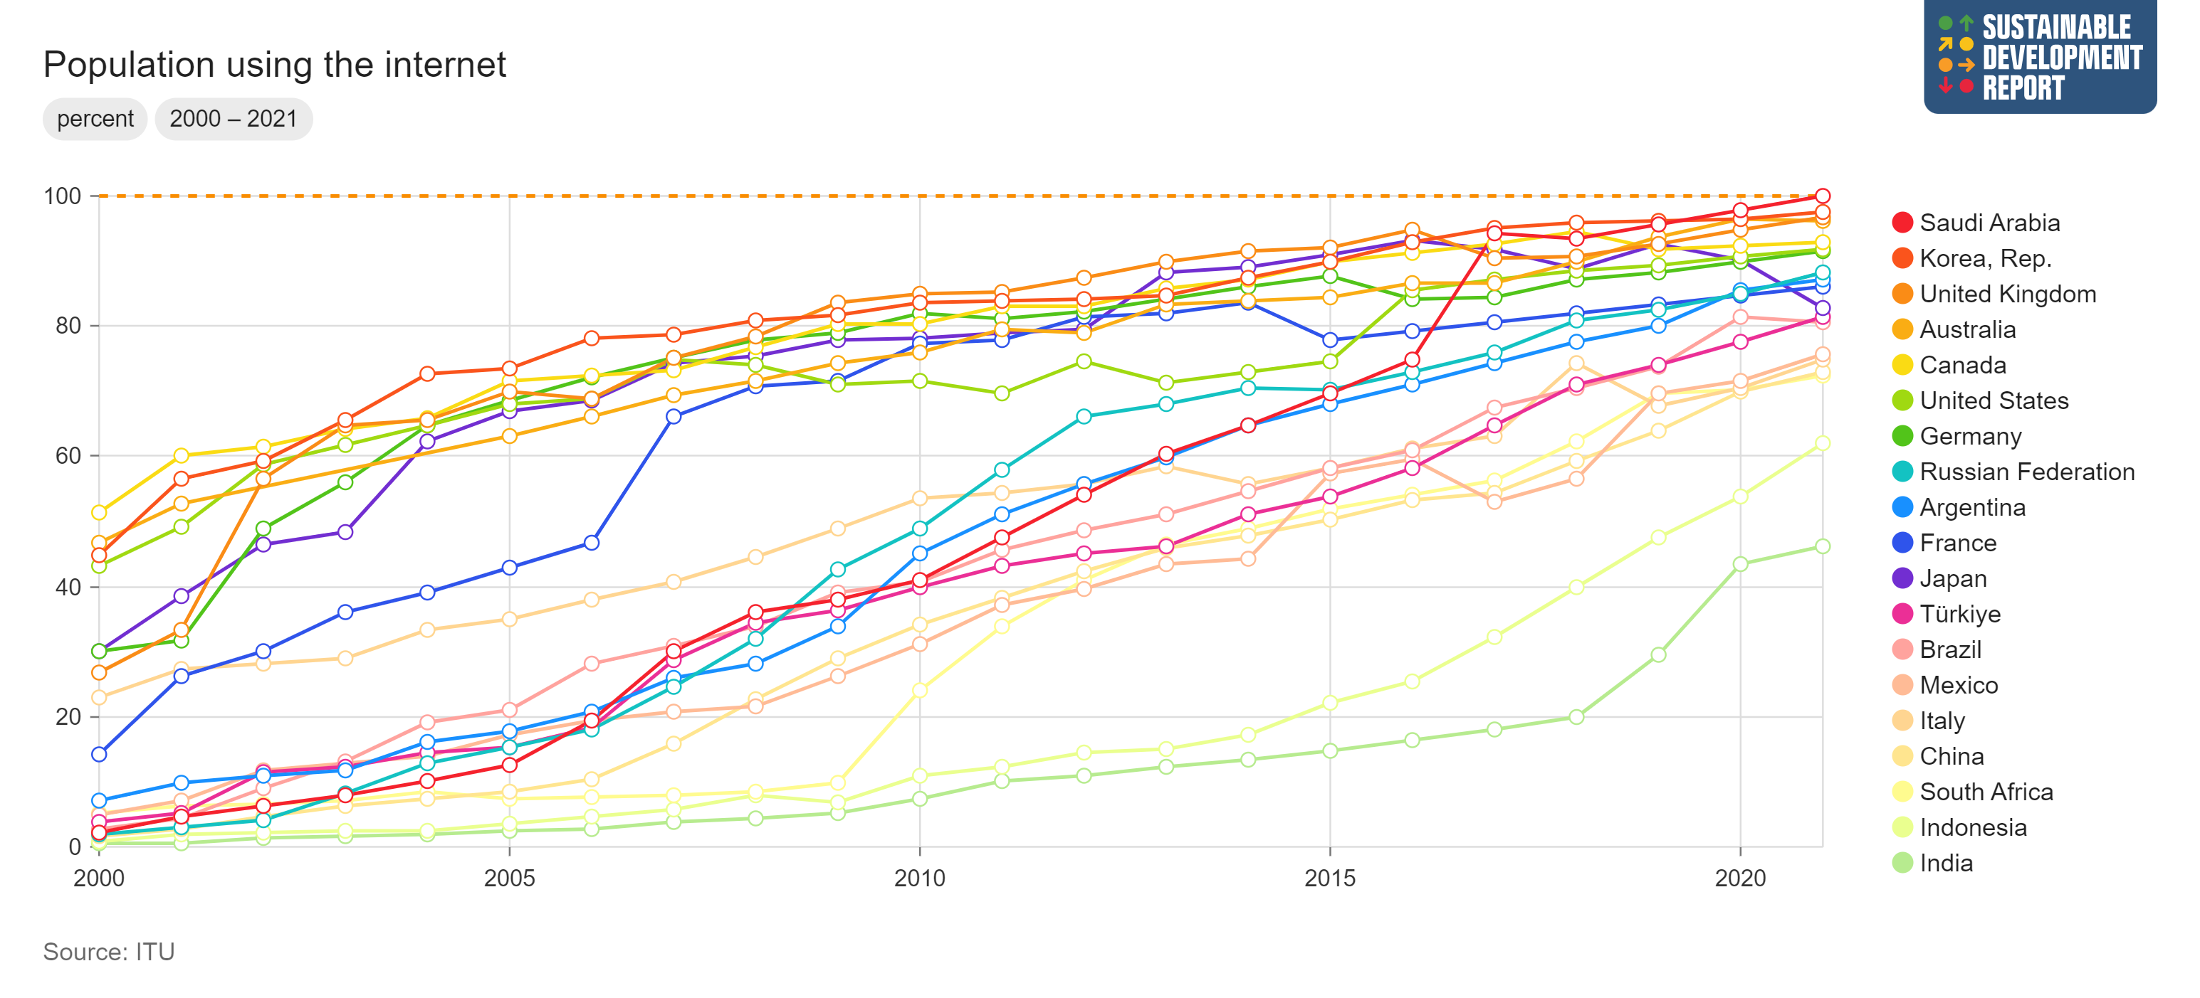

A LOOK AT THE DATA Are we all connected?
Metadata: The percentage of the population who used the Internet from any location in the last three months (via a fixed or mobile network).
Francesca Larosa, FLOW and KTH Climate Action Centre
Email: larosa@kth.se

Slide 23
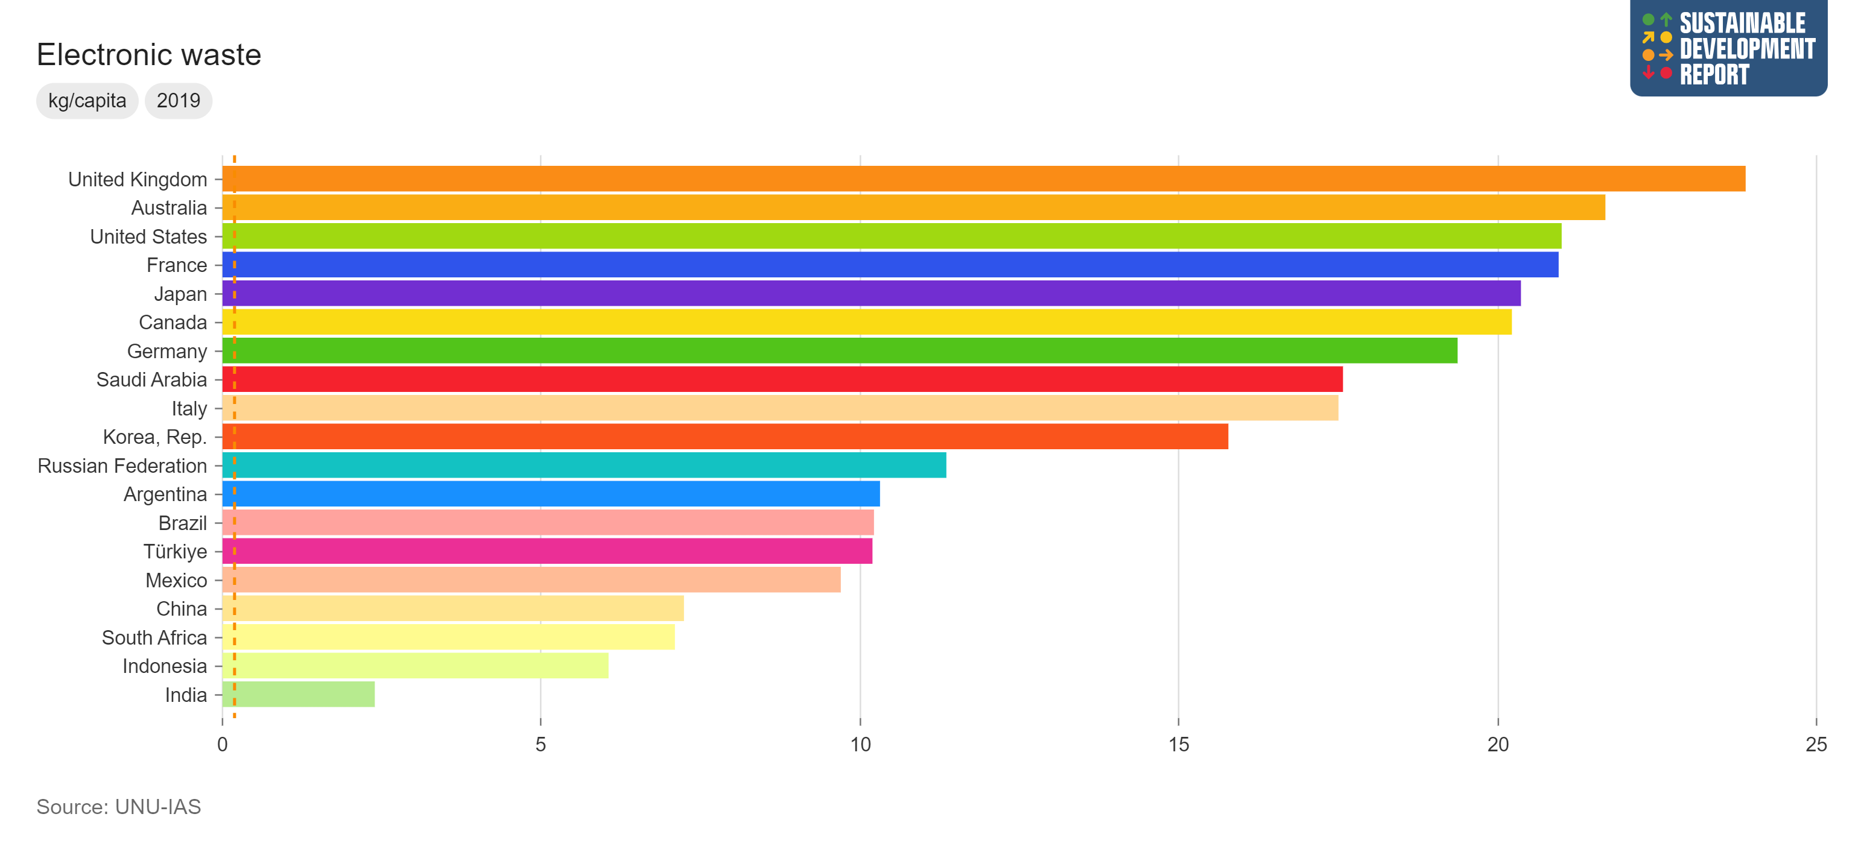

A LOOK AT DATA Are we all accessing digital technologies?
Metadata: Waste from electrical and electronic equipment, estimated based on figures for domestic production, imports and exports of electronic products, as well as product lifespan data.
Francesca Larosa, FLOW and KTH Climate Action Centre
Email: larosa@kth.se

Slide 24
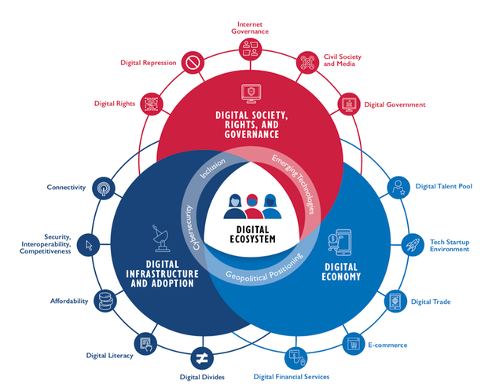
ENABLING THE TWIN TRANSITION
Digitalisation is transforming societies across the world at dramatic pace, but there is urgent need to align these transformations to sustainability objectives.
The twin transition (digital and green) leads to digitally intertwined societies and futures in which models from both spheres interact, giving rise to more complex ecosystems under constant transformations.
Let’s consider this framework: what’s missing?
Source: USAID Digital Ecosystem Framework
Francesca Larosa, FLOW and KTH Climate Action Centre
Email: larosa@kth.se

Slide 25
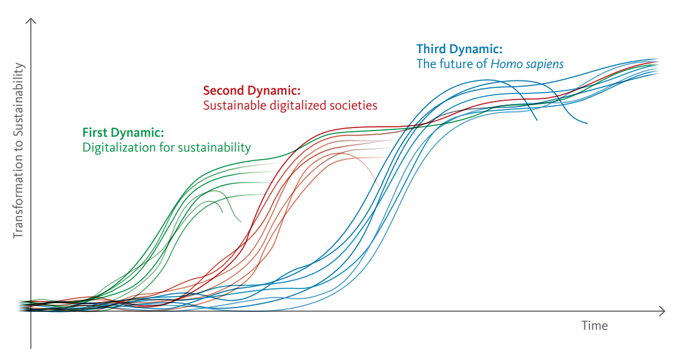
UNDERSTANDING THE IMPLICATIONS OF THE TWIN TRANSITION
Source: WBGU (2019) Towards our Common Digital Future
Francesca Larosa, FLOW and KTH Climate Action Centre
Email: larosa@kth.se
Notes:
Both the green and the digital transitions are political priorities of the policymaker that will shape our future in the long-term. While these two simultaneous, or ‘twin’, transitions, can reinforce each other in many areas, they are not automatically aligned. For example, digital technologies have substantial environmental footprints that go against the targets of the green transition. This is why a proactive and integrative approach to managing the twin transitions is important to ensure their successful implementation.

Slide 26
WHERE ARE WE NOW
Increased digital support to sustainability:
Comply with planetary boundaries
Secure social cohesion
Reduced ecological and social disruption:
Higher emissions
Increased inequality
Greater power concentration
Governance issues
Source: WBGU (2019) Towards our Common Digital Future
Francesca Larosa, FLOW and KTH Climate Action Centre
Email: larosa@kth.se

Slide 27
WHERE ARE WE GOING
New humanism:
Networked societies developing a new concept of culture and human
Shared global environmental awareness
Cooperation
Digitally-enabled and empowered totalitarism:
Empty democracies and autocracies
Massive inequality with elites domination
Environmental destruction
Source: WBGU (2019) Towards our Common Digital Future
Francesca Larosa, FLOW and KTH Climate Action Centre
Email: larosa@kth.se

Slide 28
WHERE WILL WE BE
The Homo sapiens self-confidence:
Ethically-reflected advancement of humanity
Preserving the natural habitat for the biological human
Blurred machine-human lines:
Abusive use of machines
Superintelligence
Artificial human evolution
Source: WBGU (2019) Towards our Common Digital Future
Francesca Larosa, FLOW and KTH Climate Action Centre
Email: larosa@kth.se

Slide 29
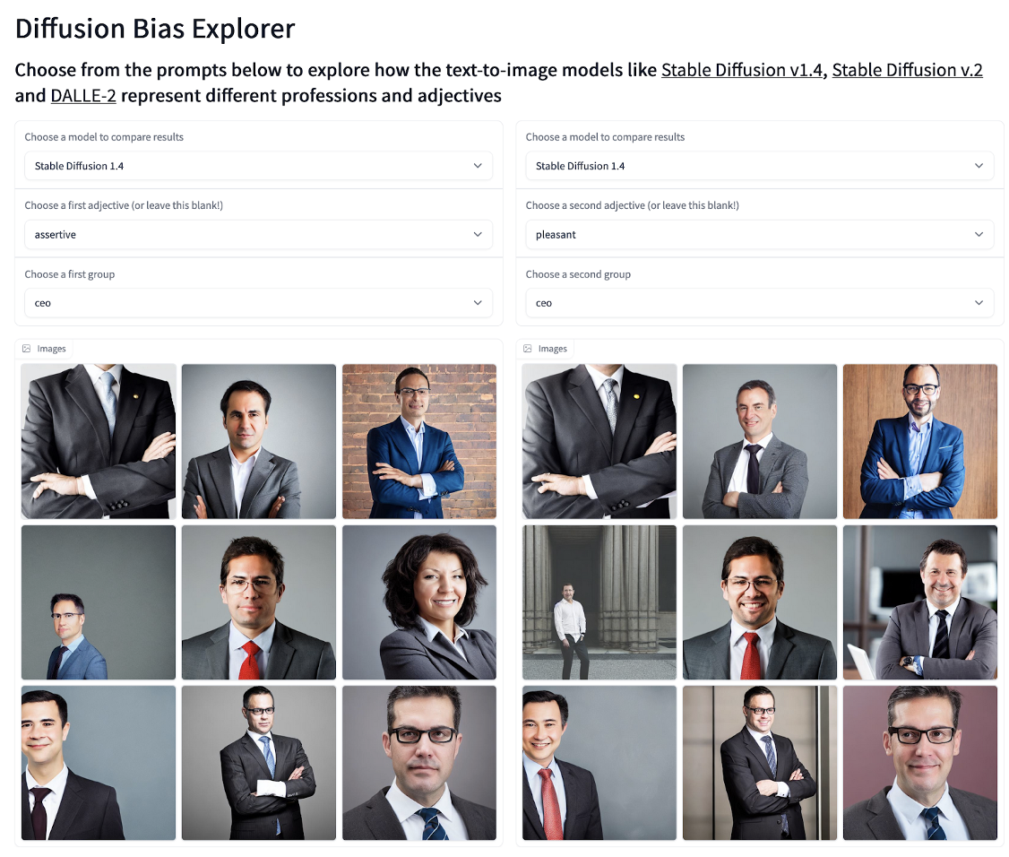
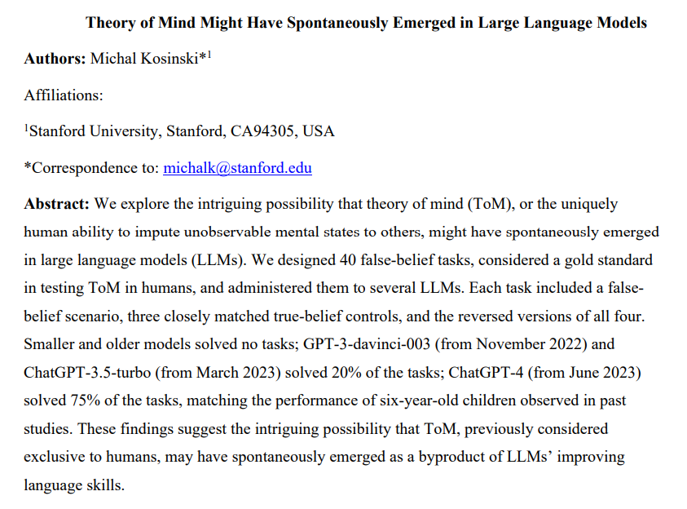
The AI hype
Source: arXiv:2302.02083
Source: The AI Index Report 2023, Stanford University
Francesca Larosa, FLOW and KTH Climate Action Centre
Email: larosa@kth.se

Slide 30
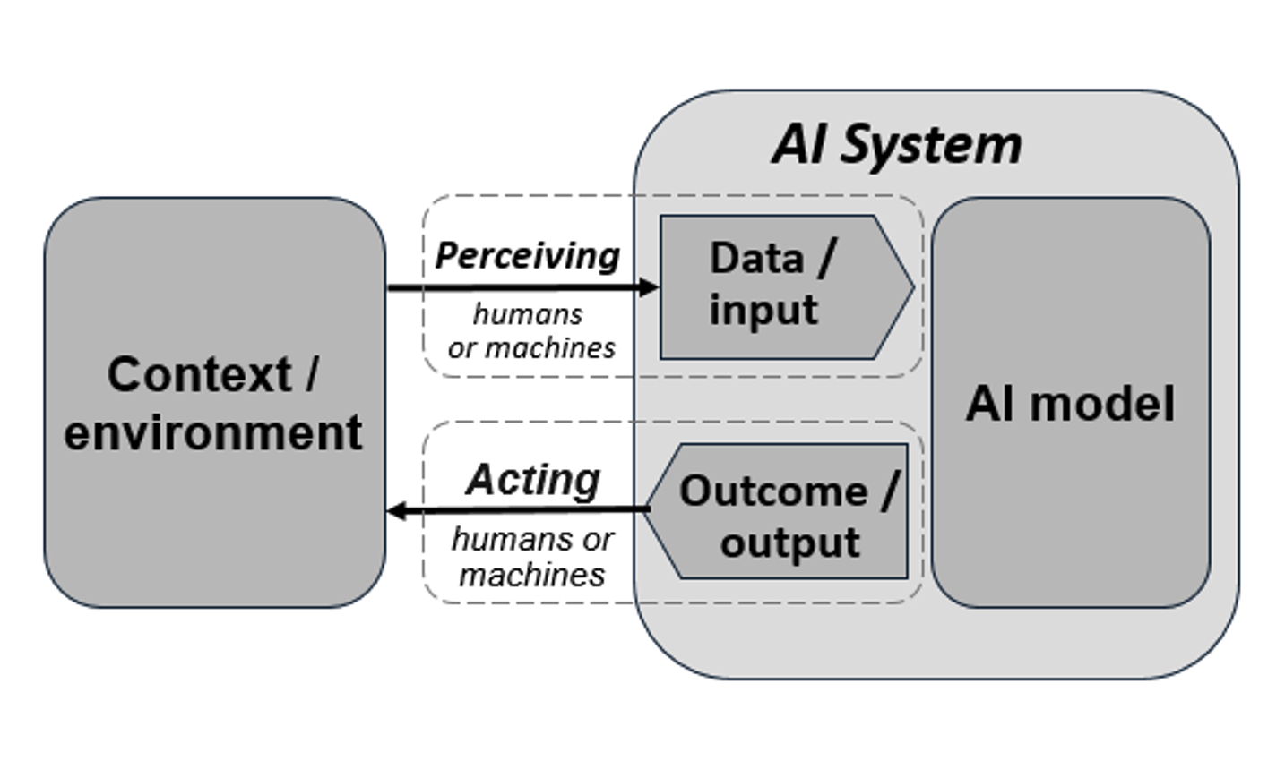
What is AI?
An AI system is a machine-based system that, for explicit or implicit objectives, infers, from the input it receives, how to generate outputs such as predictions, content, recommendations, or decisions that can influence physical or virtual environments (OECD, AI Principles)
Artificial intelligence system’ (AI system) means a system that is designed to operate with a certain level of autonomy and that, based on machine and/or human-provided data and inputs, infers how to achieve a given set of human-defined objectives using machine learning and/or logic- and knowledge based approaches, and produces system-generated outputs such as content (generative AI systems), predictions, recommendations or decisions , influencing the environments with which the AI system interacts (EU, AI Act, 2022)
Note, TO INFER: to form an opinion or guess that something is true because of the information that you have (Cambridge Dictionary). To infer derives from the Latin word “inferred”, which means “to bring in”.
Francesca Larosa, FLOW and KTH Climate Action Centre
Email: larosa@kth.se

Slide 31
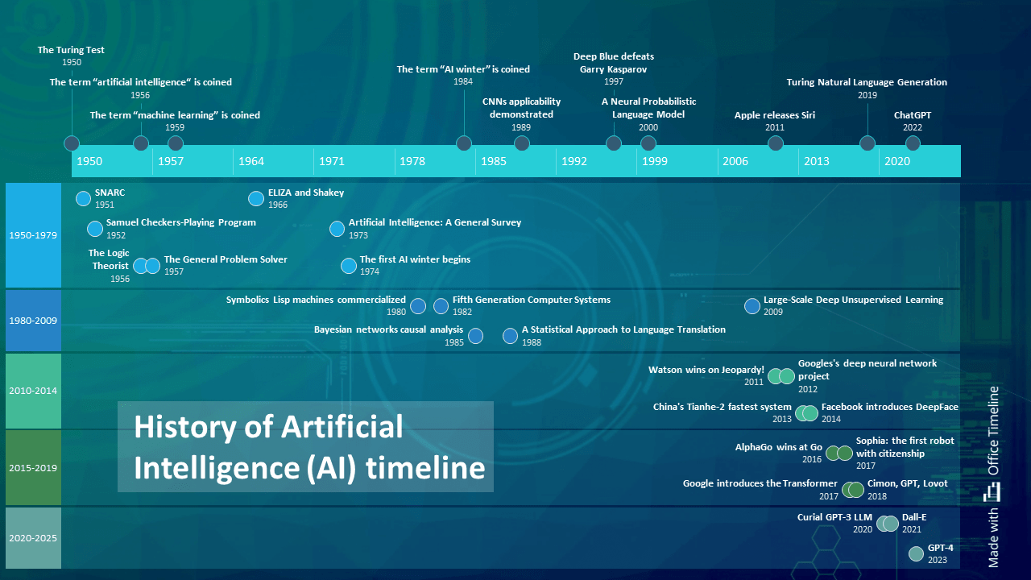
What is AI?
Francesca Larosa, VinuesaLab and KTH Climate Action Centre
Email: larosa@kth.se
Source: Malik, E. OfficeTemplate. Nov. 2023

Slide 32
What is AI?
Artificial Intelligence is coined by John McCarthy in 1955
Artificial Narrow Intelligence (ANI): Ais good at particular tasks at equal or better levels than humans (e.g., Alexa)
Artificial General Intelligence (AGI): AI which can perform any task. Large Language Models (LLMs) are the potential backbone of AGI
Artificial Superintelligence (ASI): intelligence which surpasses anything that human beings can do (e.g., the Agent from The Matrix)
I propose to consider the question, "Can machines think?“
A. M. Turing (1950) Computing Machinery and Intelligence. Mind 49: 433-460
Francesca Larosa, FLOW and KTH Climate Action Centre
Email: larosa@kth.se

Slide 33
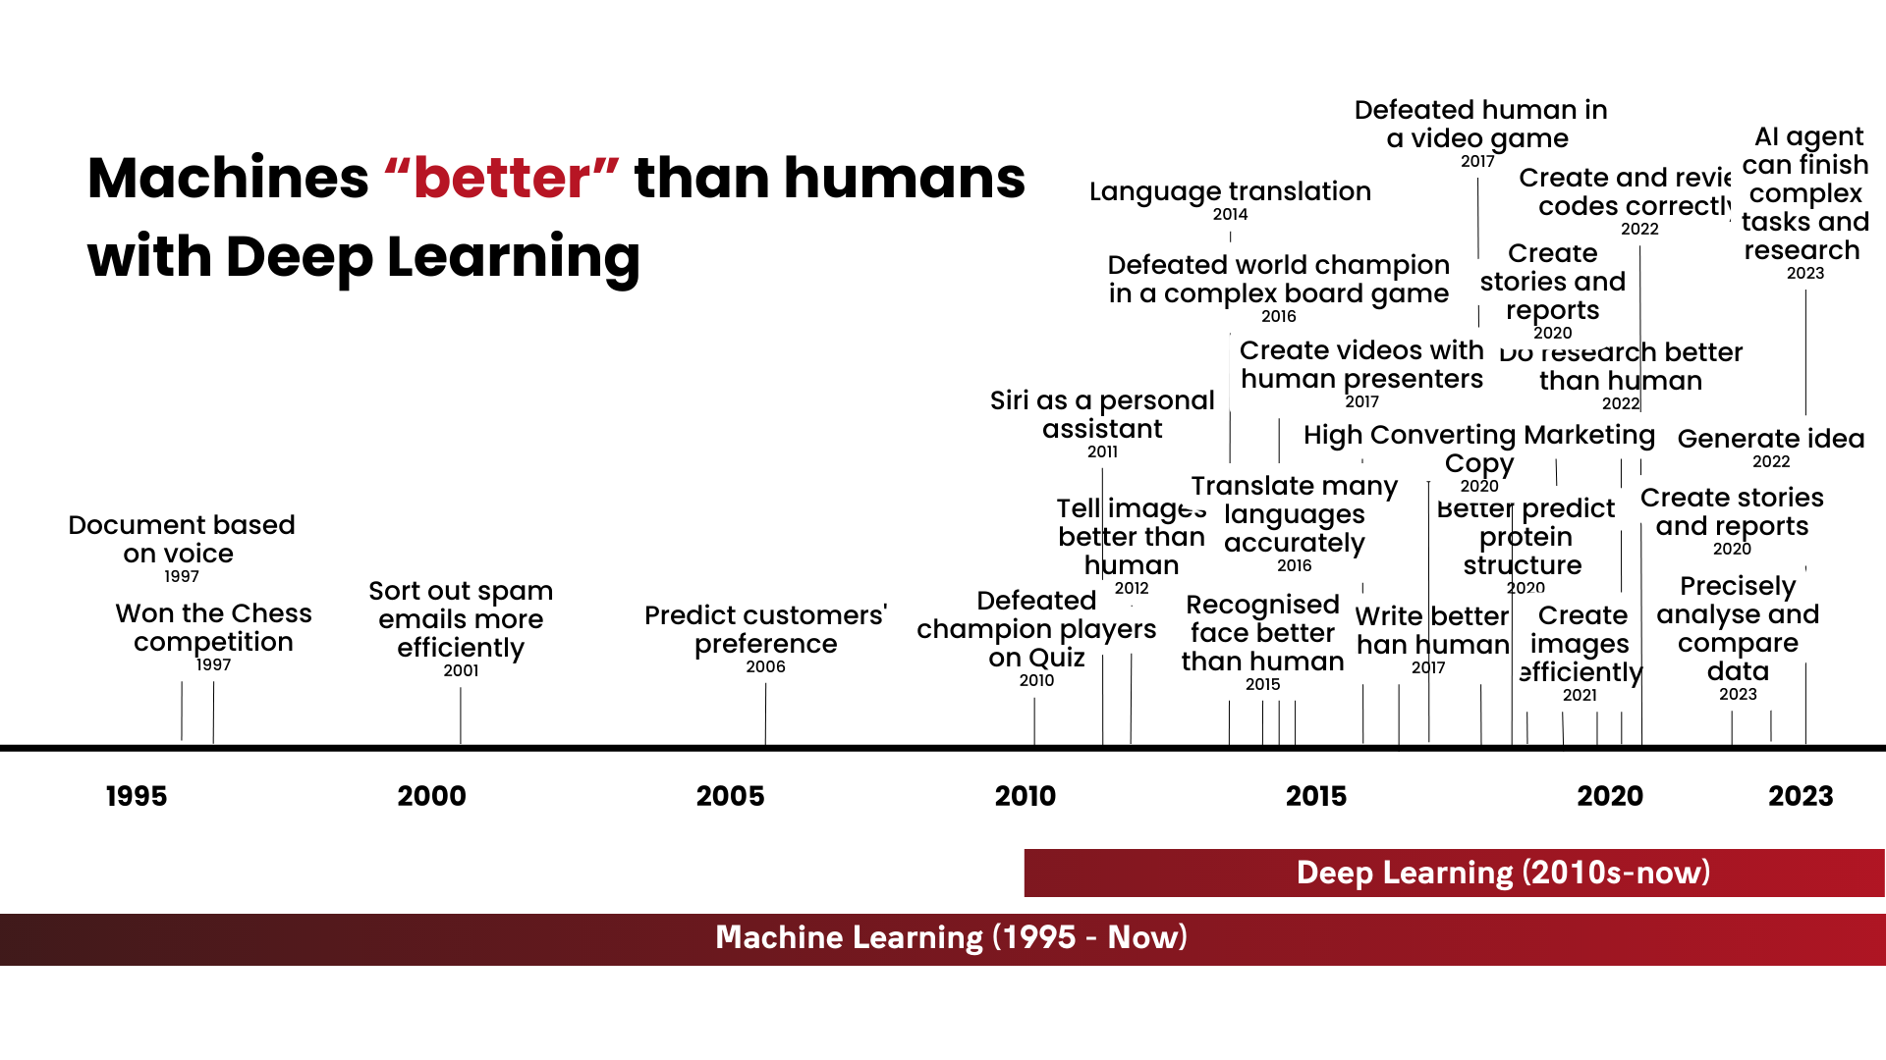
What is AI?
Francesca Larosa, VinuesaLab and KTH Climate Action Centre
Email: larosa@kth.se
Source: The New Skills in an AI World Report 2023, CFTE

Slide 34
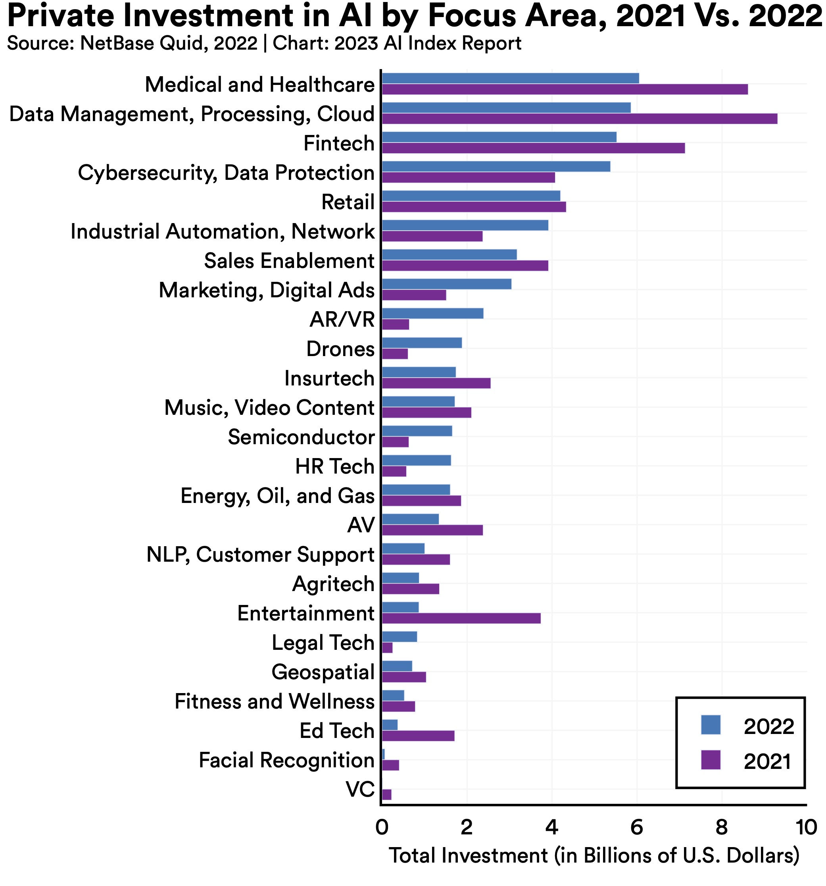
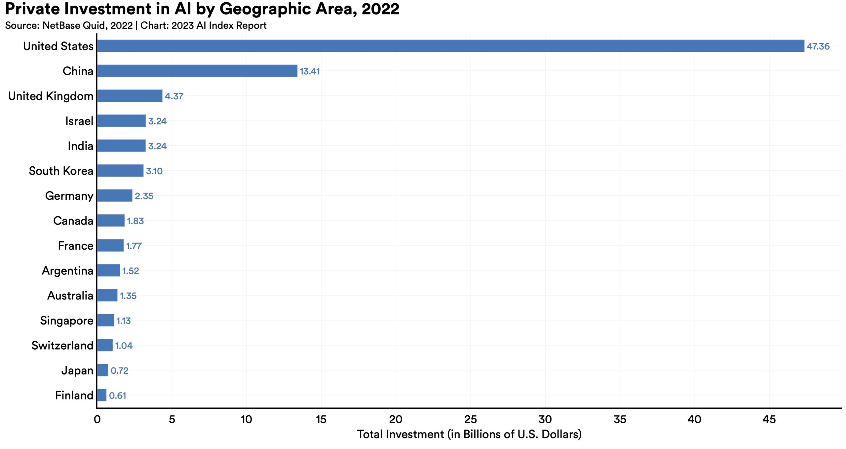
The AI economy
Source: The AI Index Report 2023, Stanford University
Francesca Larosa, FLOW and KTH Climate Action Centre
Email: larosa@kth.se

Slide 35
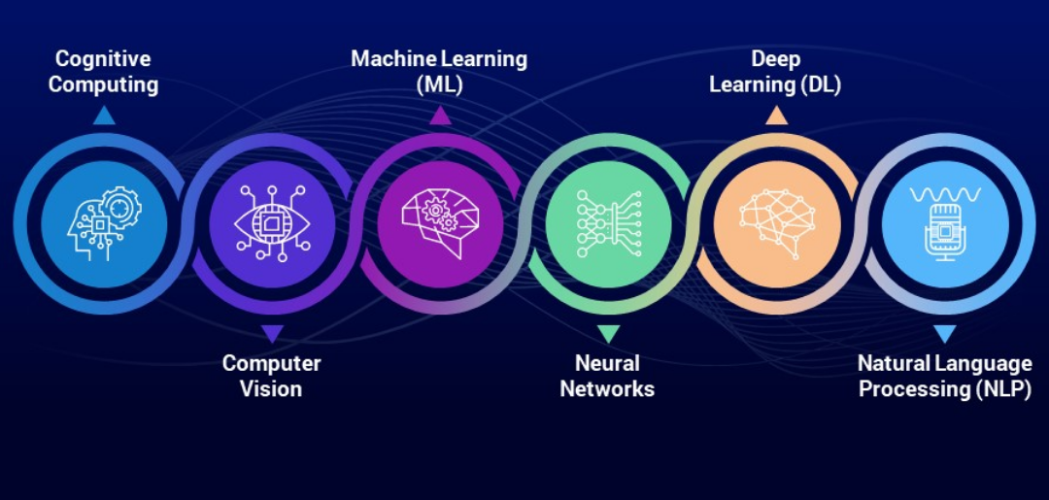
The AI capabilities: a non-exhaustive overview
https://rancholabs.medium.com/6-major-sub-fields-of-artificial-intelligence-77f6a5b28109
Source
Francesca Larosa, VinuesaLab and KTH Climate Action Centre
Email: larosa@kth.se

Slide 36
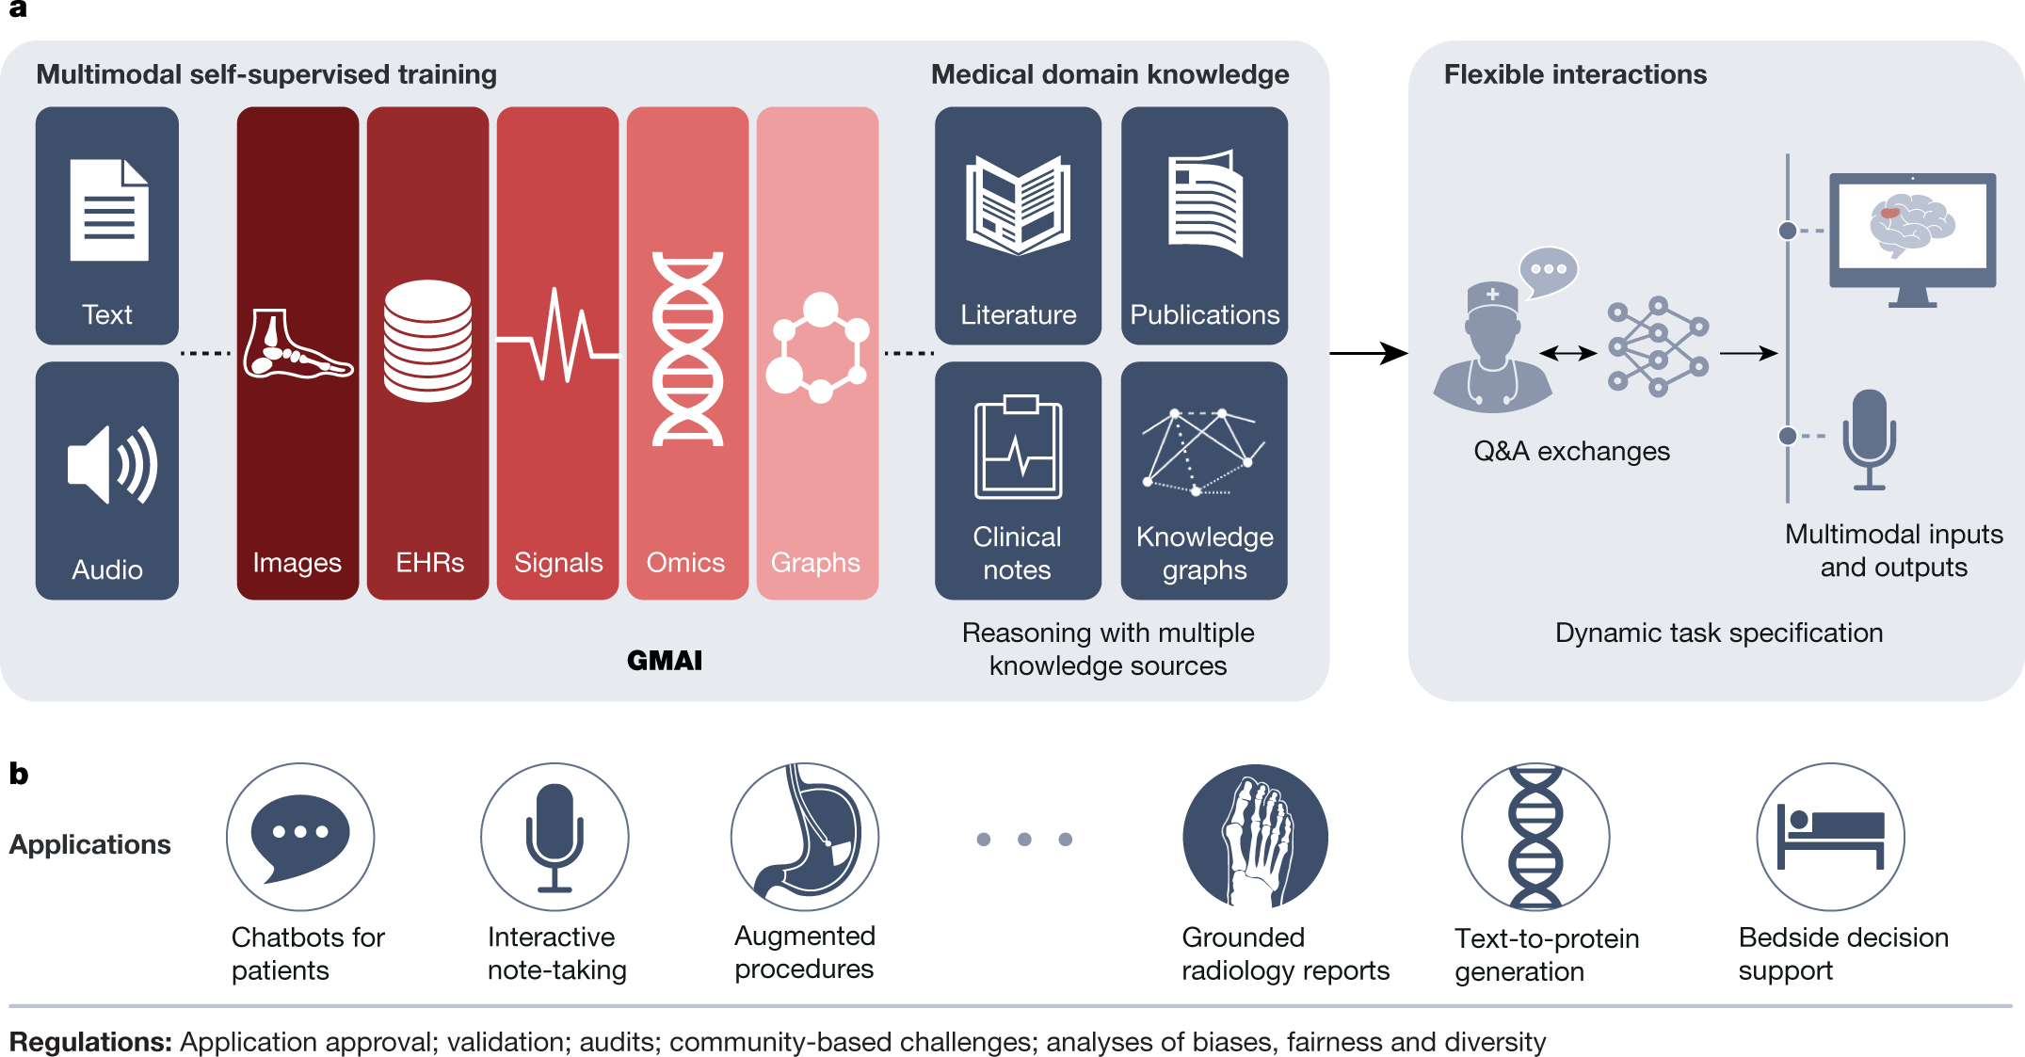
An example of the potentialities of AI capabilities: Medicine
Moor, M., Banerjee, O., Abad, Z.S.H. et al. Foundation models for generalist medical artificial intelligence. Nature 616, 259–265 (2023). https://doi.org/10.1038/s41586-023-05881-4
Francesca Larosa, FLOW and KTH Climate Action Centre
Email: larosa@kth.se

Slide 37
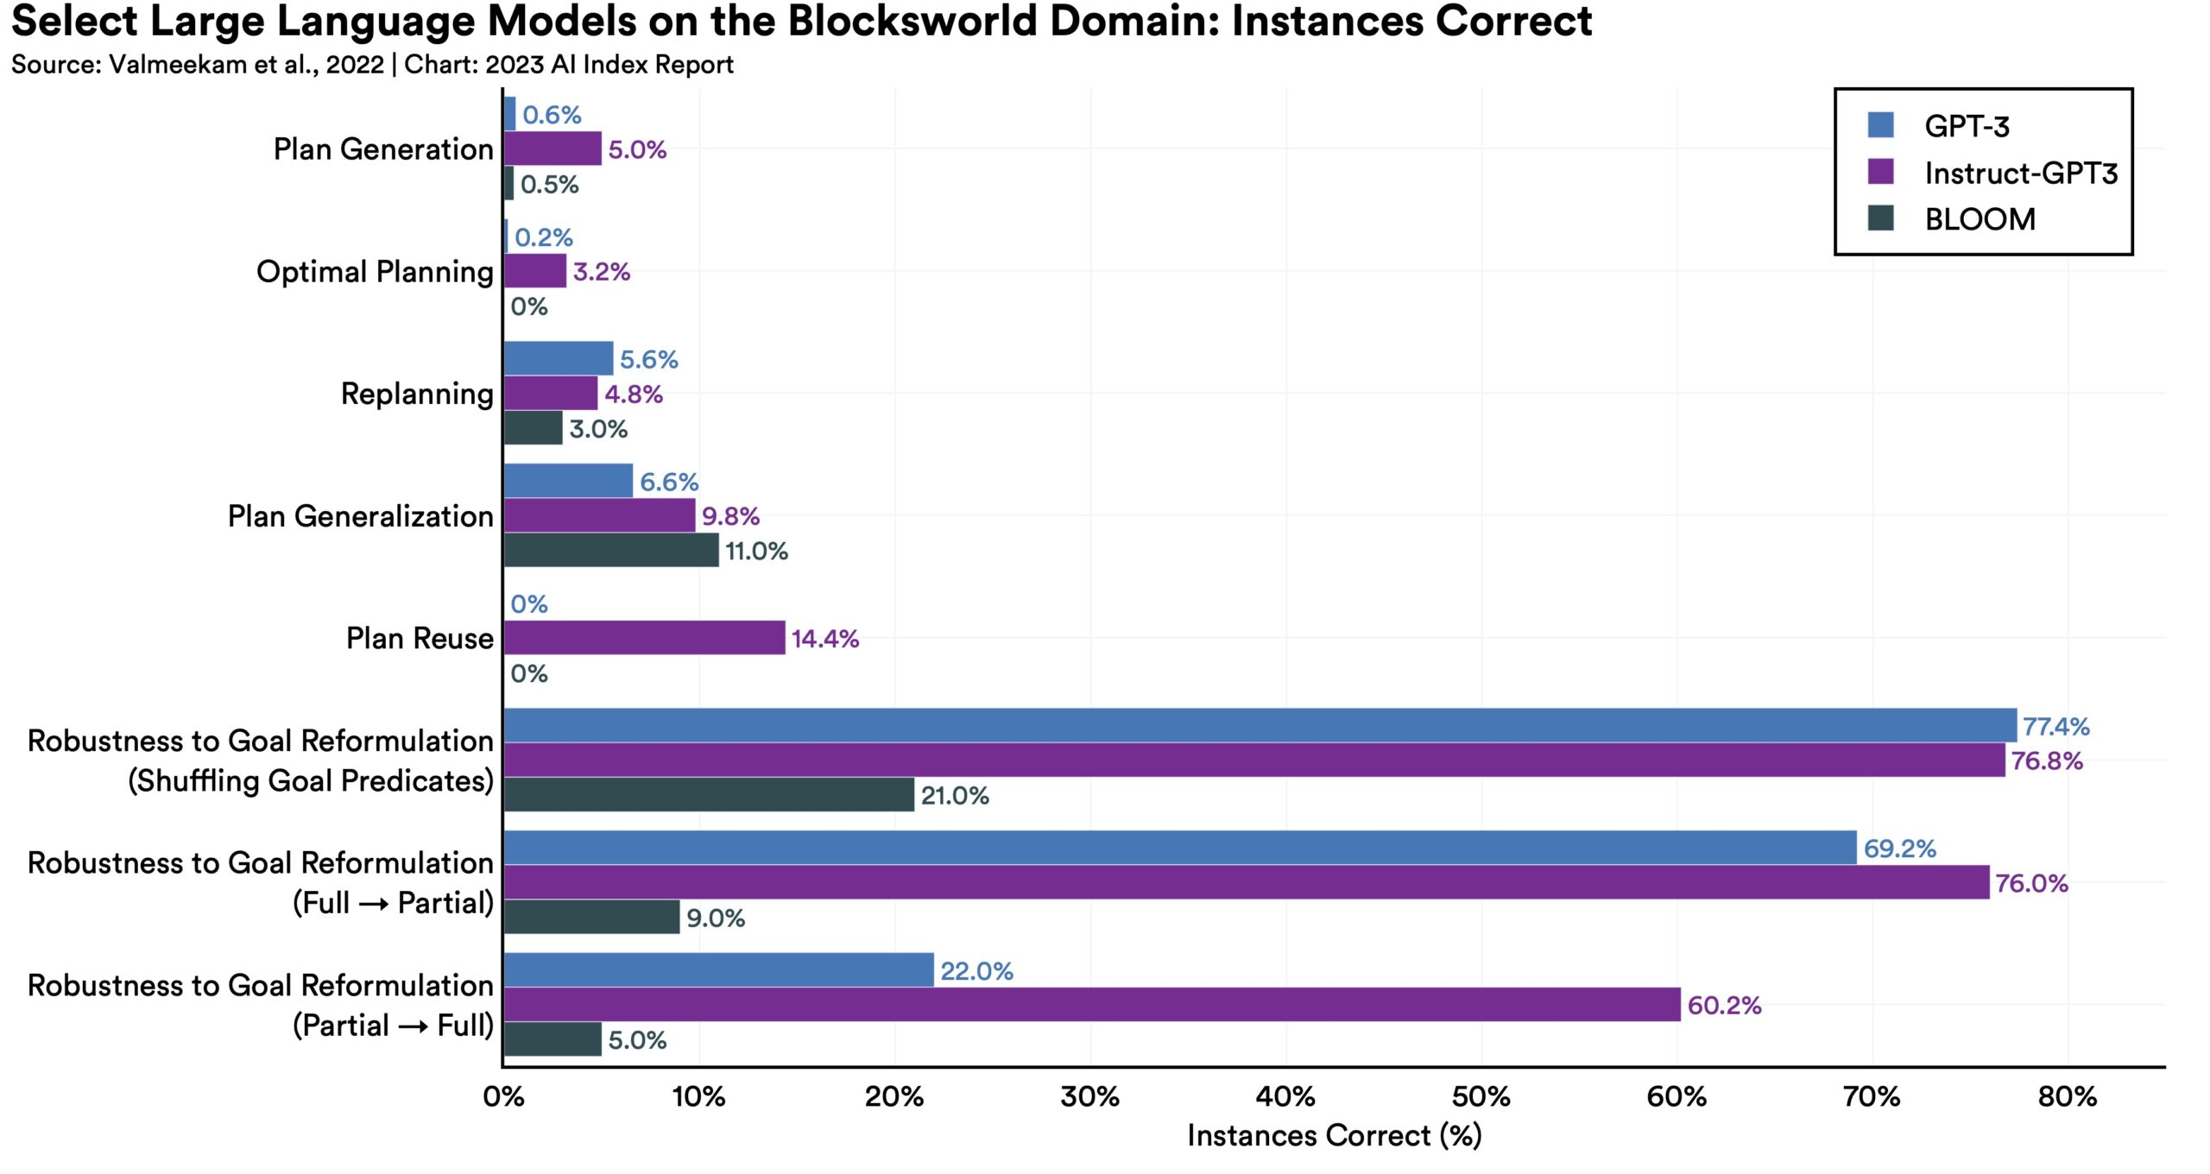
The AI capabilities
Source: The AI Index Report 2023, Stanford University
Francesca Larosa, FLOW and KTH Climate Action Centre
Email: larosa@kth.se

Slide 38
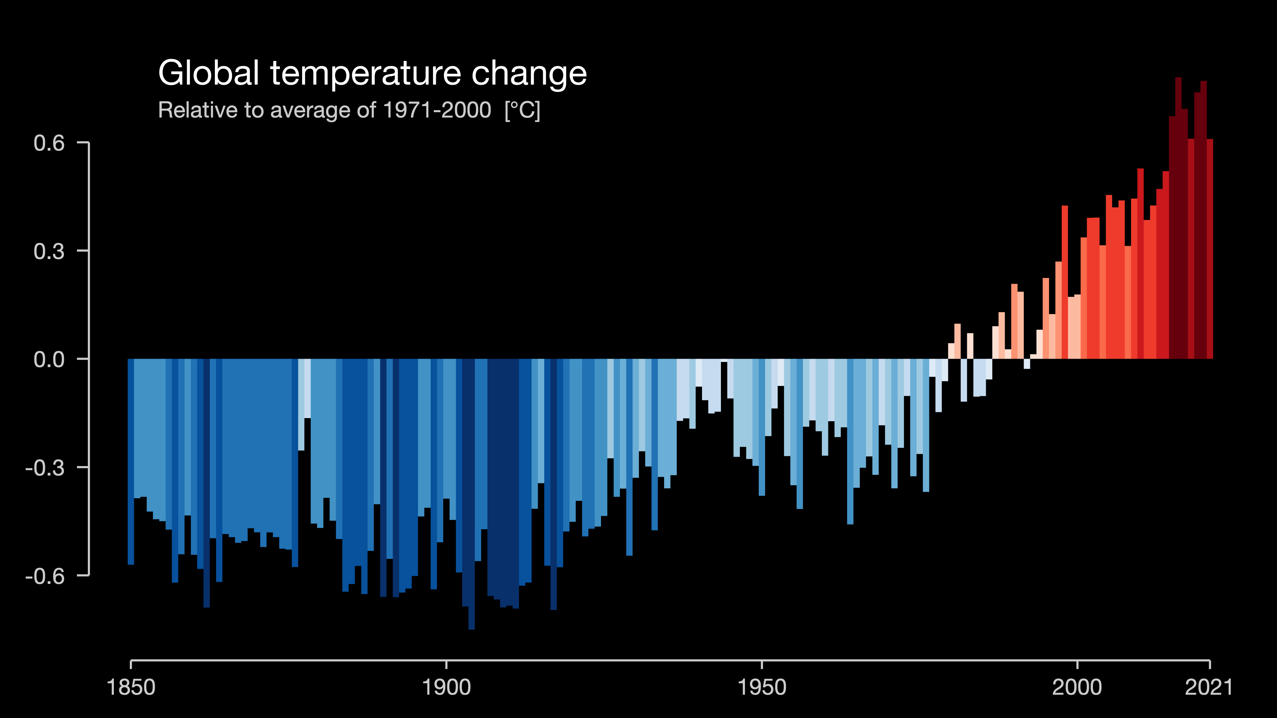
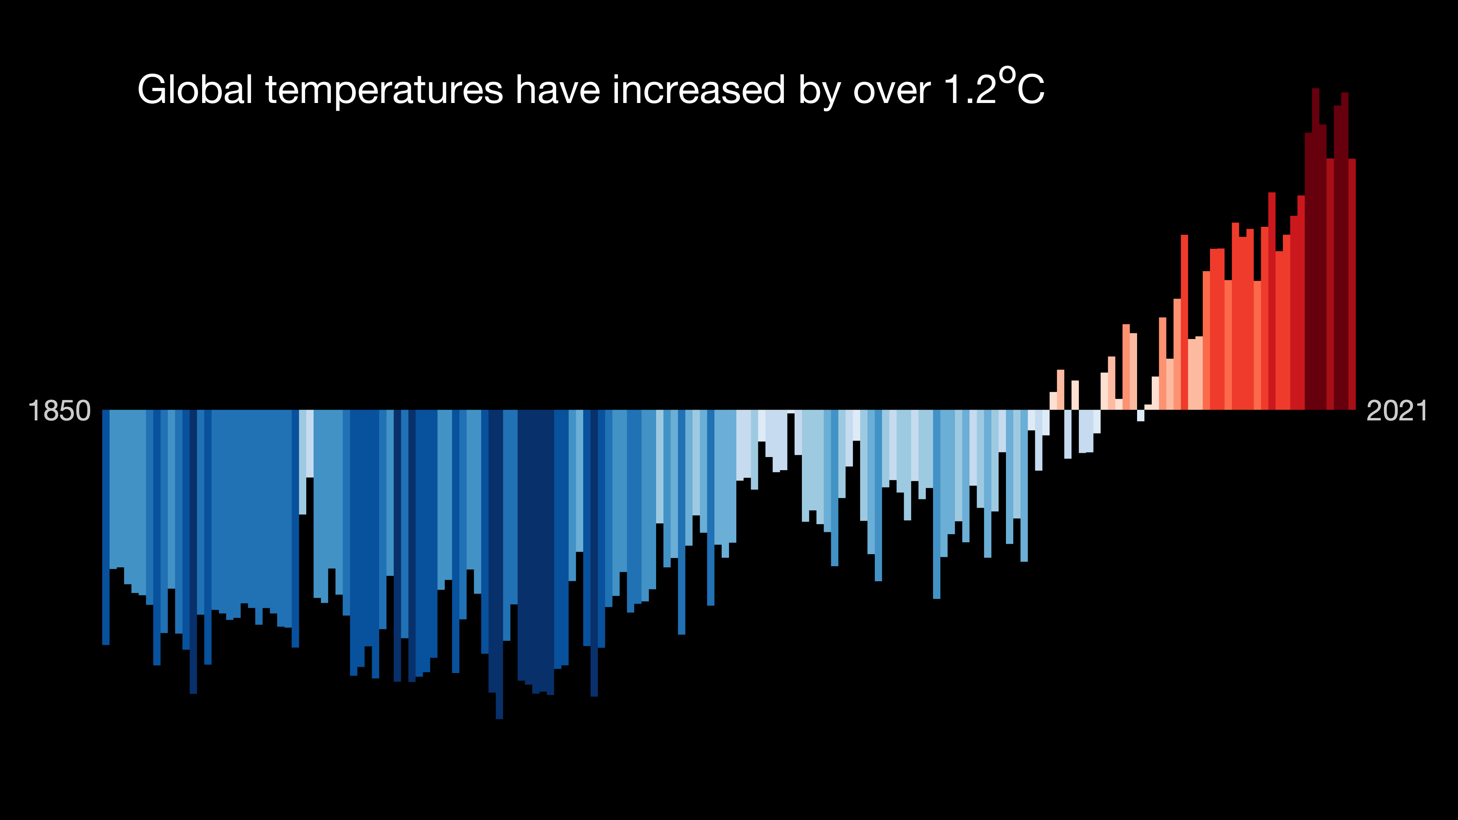
Setting the problem
Figure source: #ShowYourStripes
Data source: UK Met Office
Creator: Ed Hawkins
Francesca Larosa, VinuesaLab and KTH Climate Action Centre
Email: larosa@kth.se

Slide 39

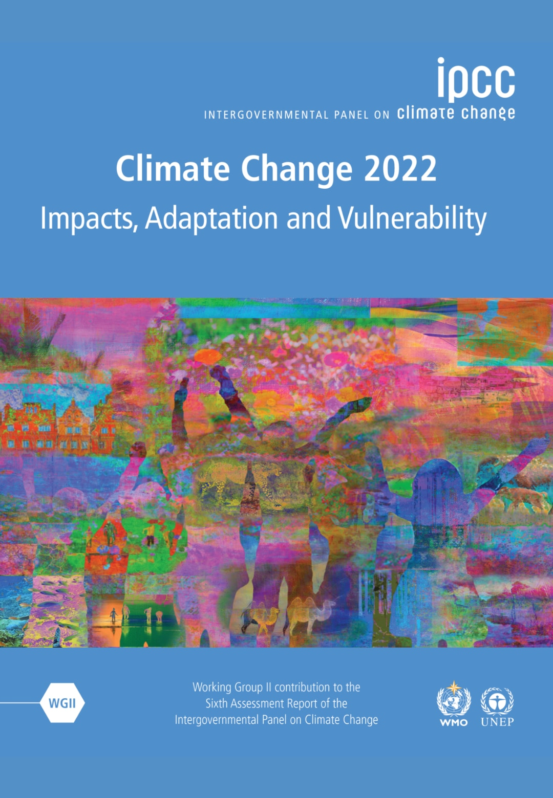
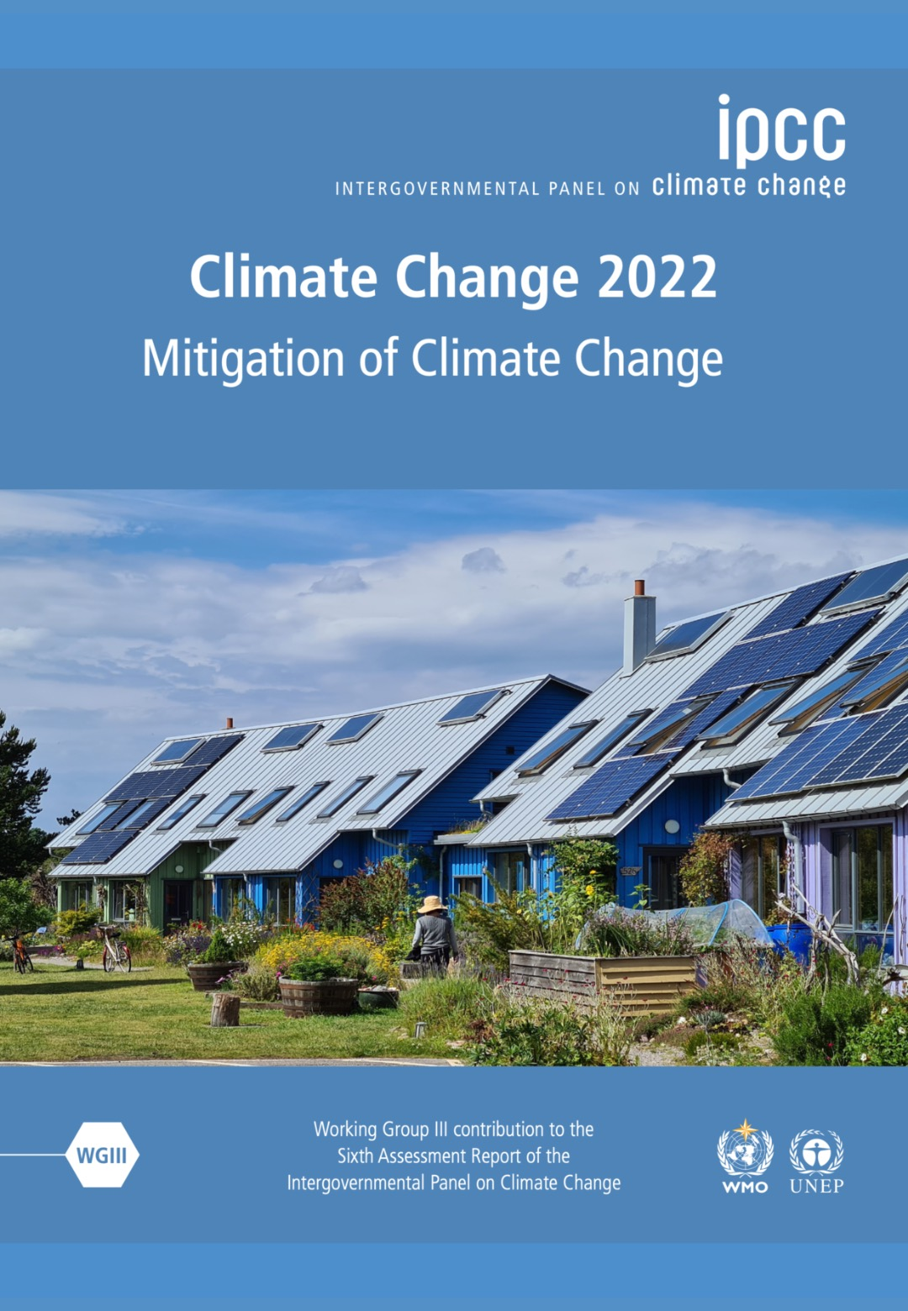
What the science says
“It is unequivocal that human influence has warmed the atmosphere, ocean and land. Widespread and rapid changes in the atmosphere, ocean, cryosphere and biosphere have occurred” (IPCC, AR6 WGI, 2021)
“Global warming, reaching 1.5°C in the near-term, would cause unavoidable increases in multiple climate hazards and present multiple risks to ecosystems and humans (very high confidence) […] Some responses to climate change result in new impacts and risks (high confidence).” (IPCC, AR6, WGII, 2022)
The unit costs of several low-emission technologies have fallen continuously since 2010. Innovation policy packages have enabled these cost reductions and supported global adoption. […] Innovation has lagged in developing countries due to weaker enabling conditions. Digitalisation can enable emission reductions, but can have adverse side-effects unless appropriately governed. (high confidence) (IPCC, AR6, WGIII, 2022)
Francesca Larosa, VinuesaLab and KTH Climate Action Centre
Email: larosa@kth.se

Slide 40
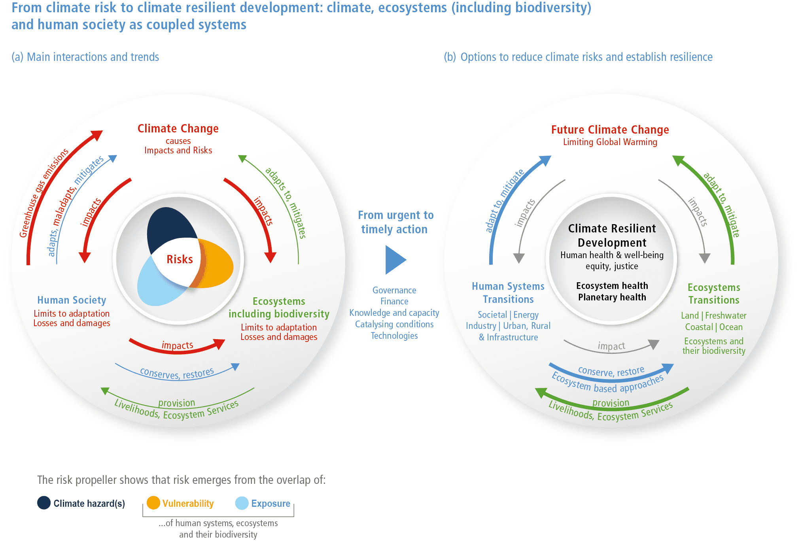
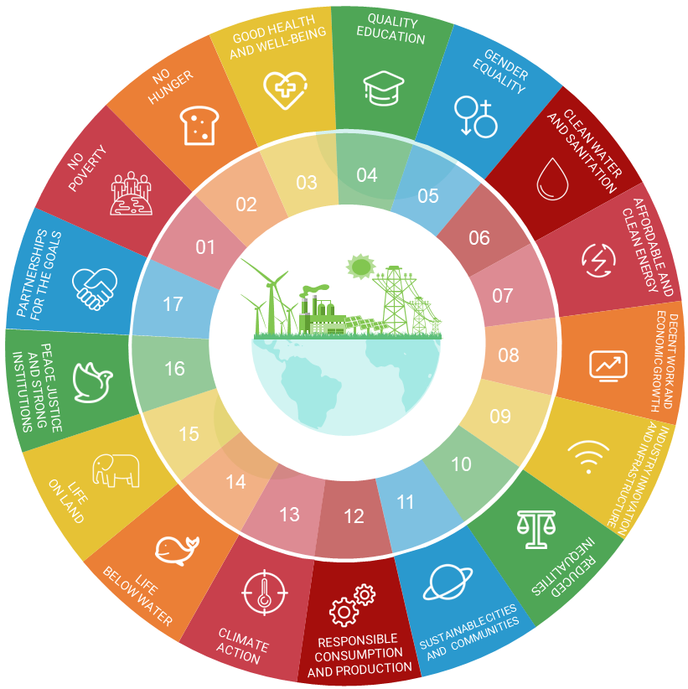
Climate-society feedback loops
Adaptation
Mitigation
Policy
Adaptation
Source: IPCC AR6, WGII
Francesca Larosa, VinuesaLab and KTH Climate Action Centre
Email: larosa@kth.se

Slide 41
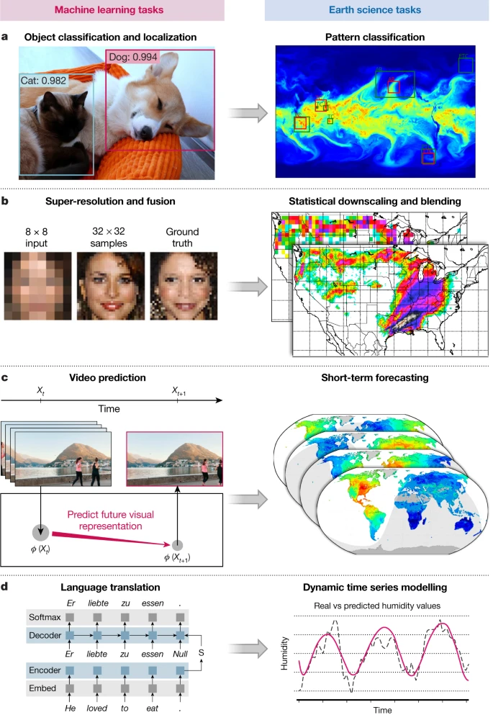
What can ML and AI do for the climate
Understand our physical climate
Data issues: sensor calibration and classification of observational data
Improving climate models: 1) combine deep neural networks with thermodynamics help solving the largest source of undertainty in climate models, clouds. 2) Ice sheets are the most important targets for climate models improvements. Arctic climates control the future of Earth’s warming.
Detect relationships between climate variables: teleconnections, pattern recognition and regression models to quantify non-linear relationships
Forecasting extreme events: using ML to bridge weather and climate forecasts by focusing on seasonal (3month, 6month) timescale
Source: Reichstein et al., (2019). Nature 566, 195-204
Francesca Larosa, VinuesaLab and KTH Climate Action Centre
Email: larosa@kth.se

Slide 42
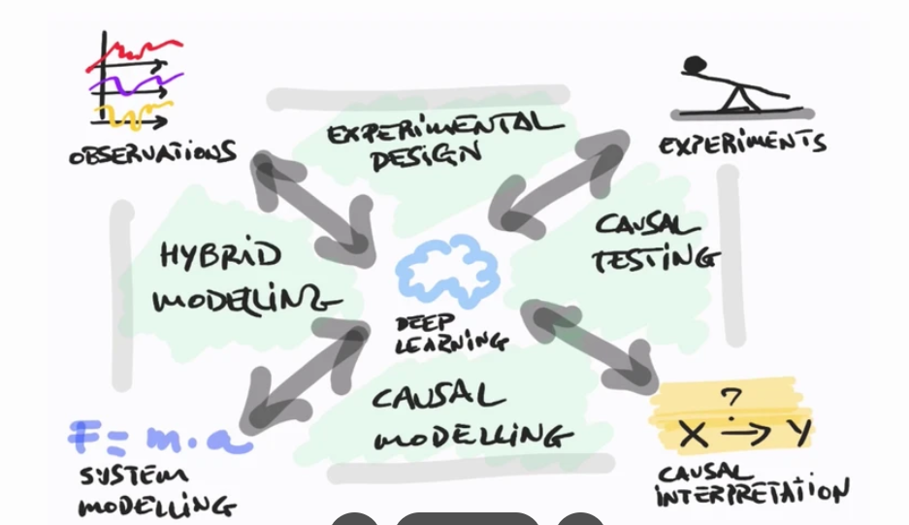
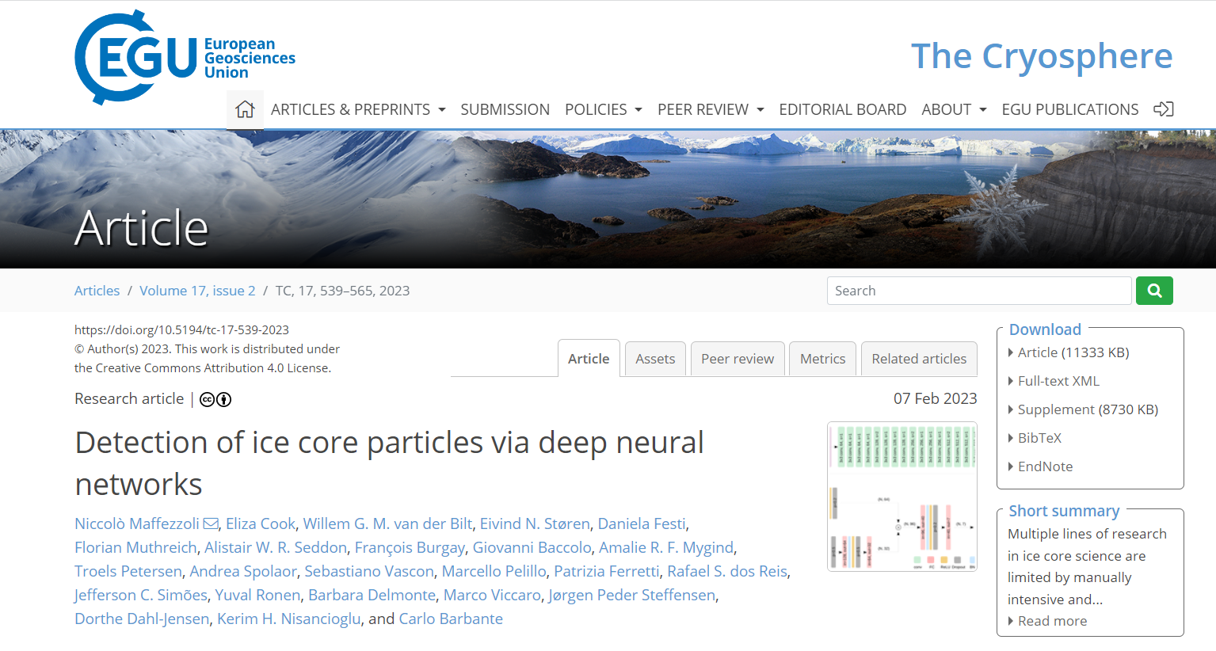


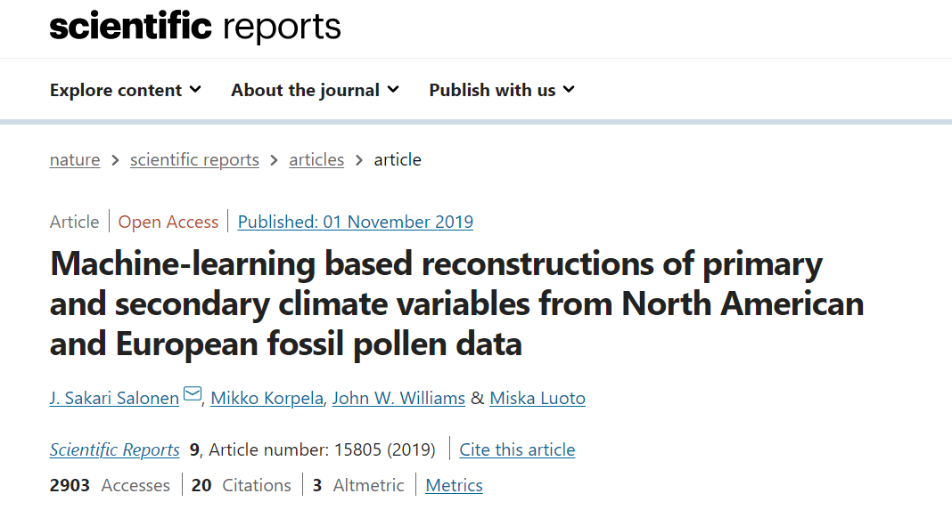
Francesca Larosa, VinuesaLab and KTH Climate Action Centre
Email: larosa@kth.se

Slide 43
What can Machine Learning and AI do for the climate
Change to electricity systems, transportation, buildings, industry and land use
Mitigation
Forecasting low-carbon energy supply and demand: better short-term forecasts allow the system to reduce reliance on polluting standby plants.
Speeding up power system optimisation problems: reinforcement learning to balance the electric grid in real time or to set real time electricity prices (Antonopolous et al. 2020)
Understand transport data to reduce transport activity: use neural networks to classify roads with similar patterns
Estimating GHG emission (point and non-point sources)
Francesca Larosa, VinuesaLab and KTH Climate Action Centre
Email: larosa@kth.se

Slide 44
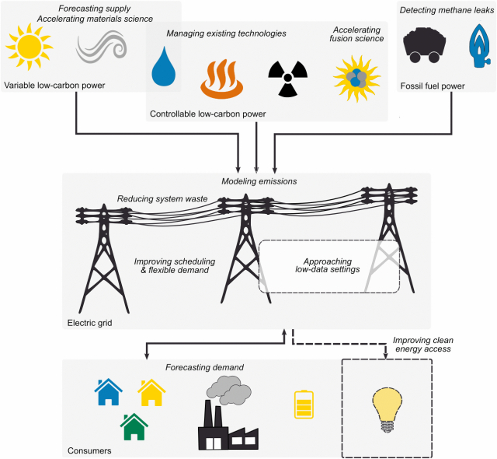
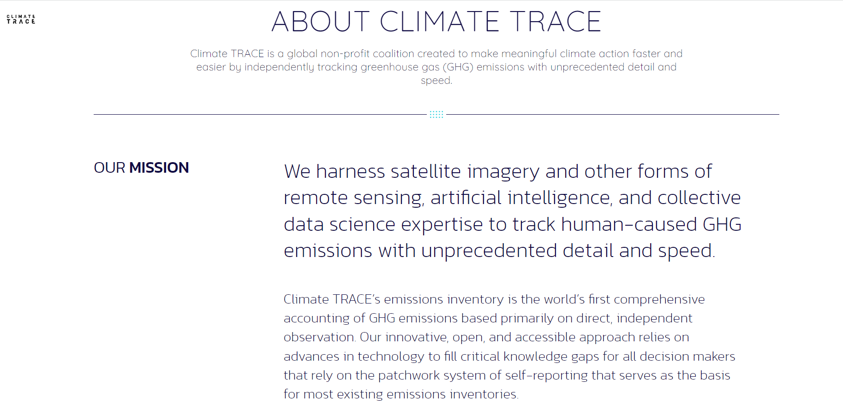
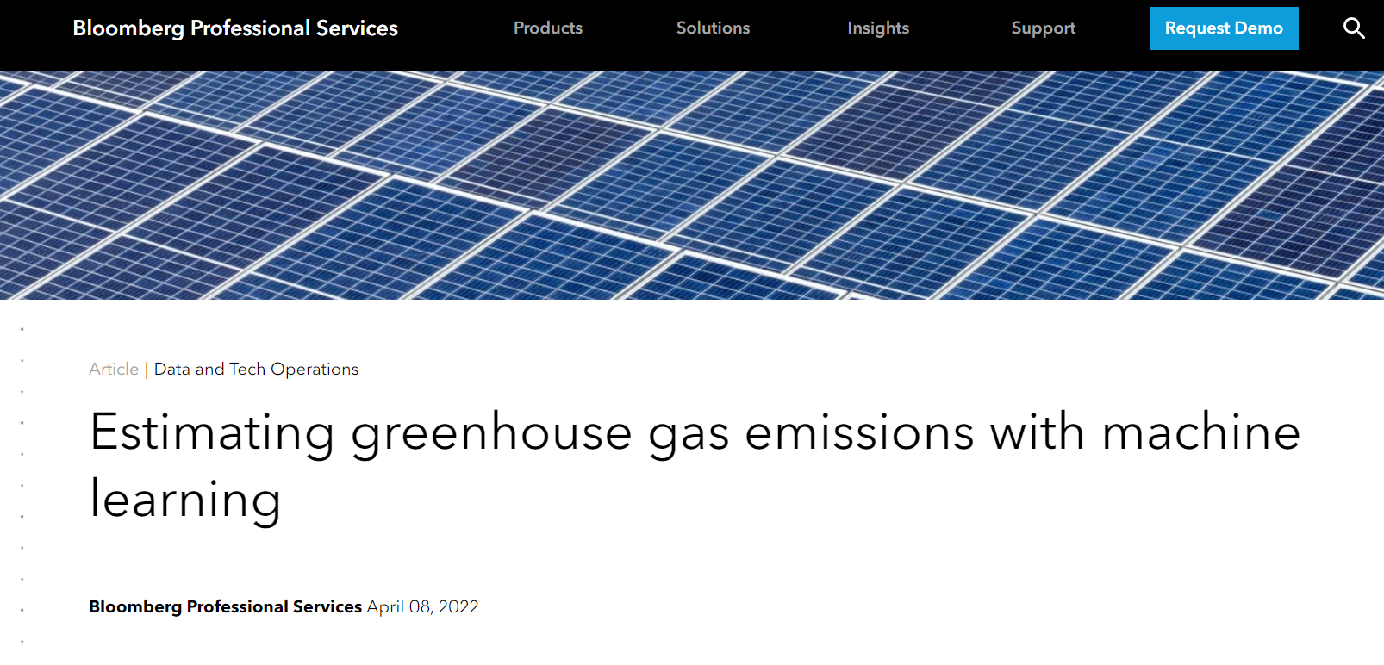
Francesca Larosa, VinuesaLab and KTH Climate Action Centre
Email: larosa@kth.se

Slide 45
What can Machine Learning and AI do for the climate
Plan for resilience and disaster management, given an understanding of climate and extreme events
Adaptation
Forecasting extreme events to improve resilience of humans and assets
Simulate climate-human interactions to plan interventions
Use language models and AI-based image processing to develop new and assess existing adaptation plans
Assess vulnerabilities by improved estimations of climate risks: application in supply chains
Mapping evidence to understand maladaptation
Climate adaptation is essential to safeguard the Sustainable Development Goals (Fuldauer et al., 2022), but AI applications are still at infancy
Adaptation
Francesca Larosa, VinuesaLab and KTH Climate Action Centre
Email: larosa@kth.se

Slide 46
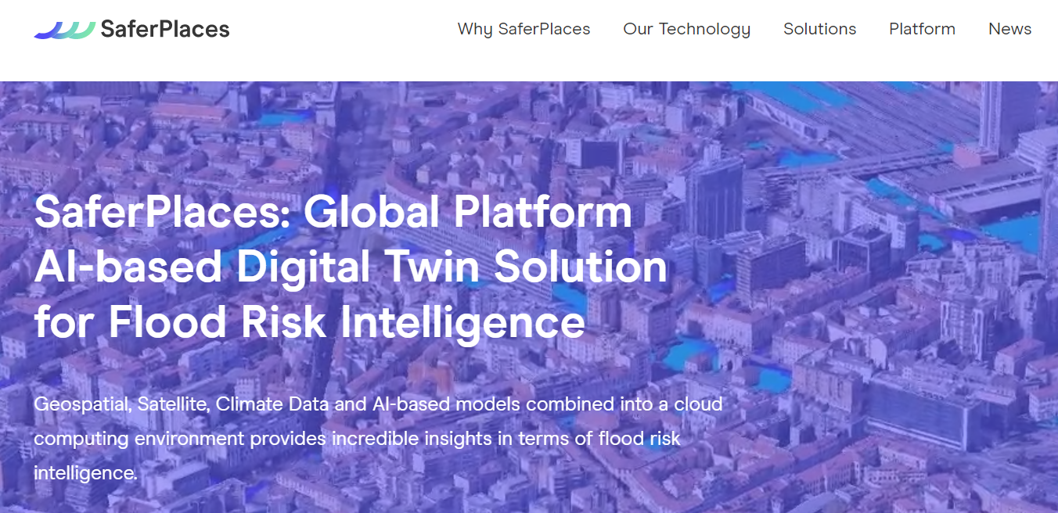
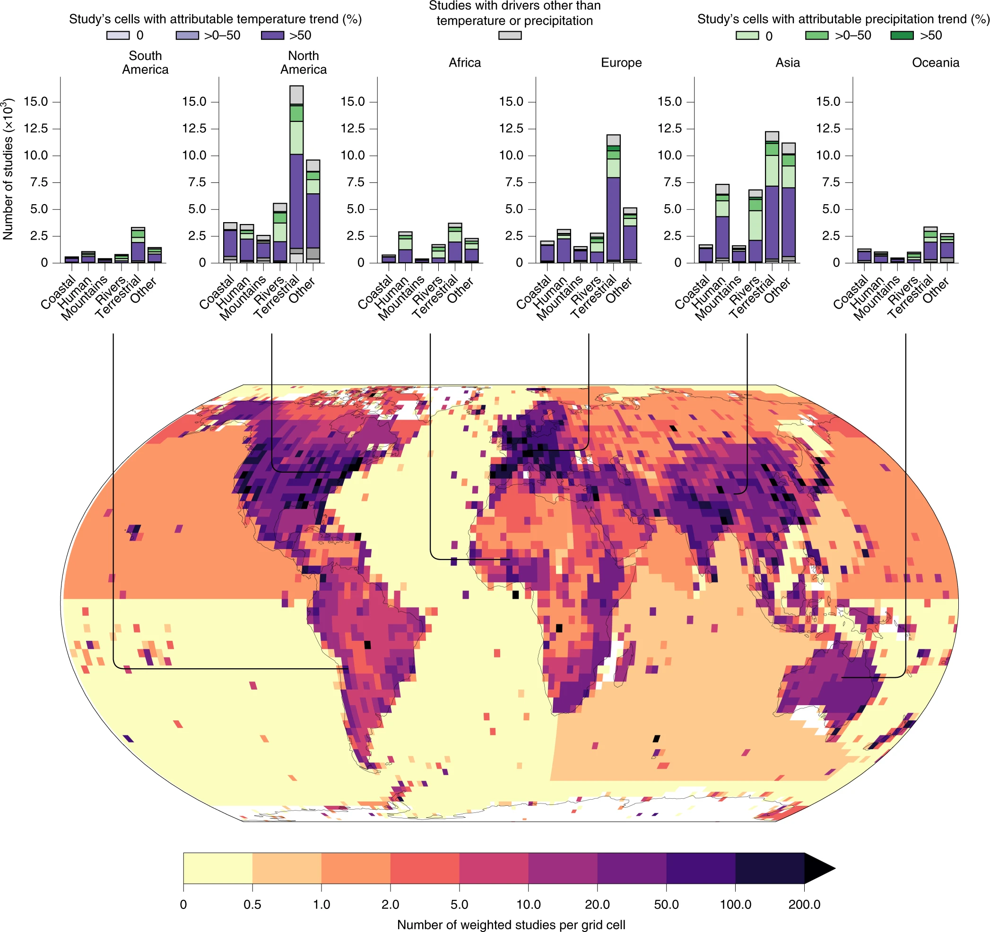
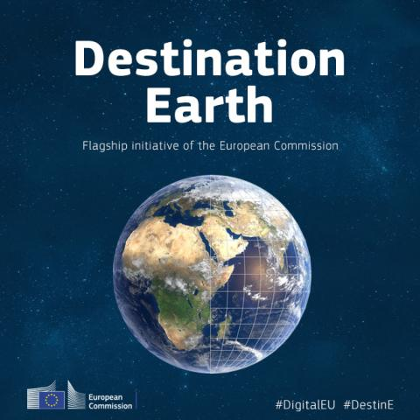
Francesca Larosa, VinuesaLab and KTH Climate Action Centre
Email: larosa@kth.se

Slide 47
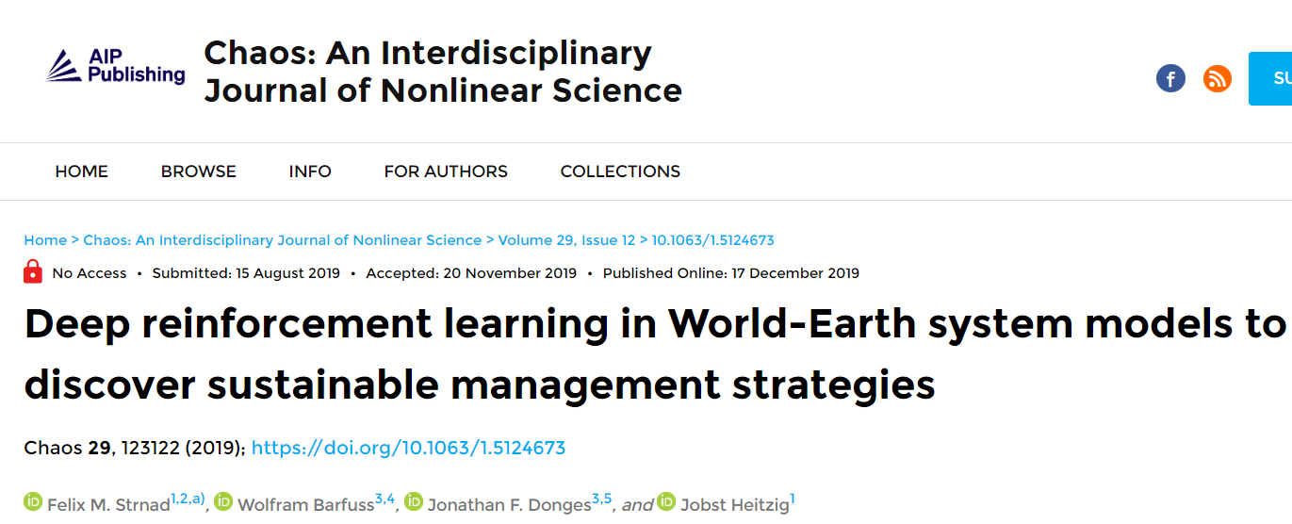
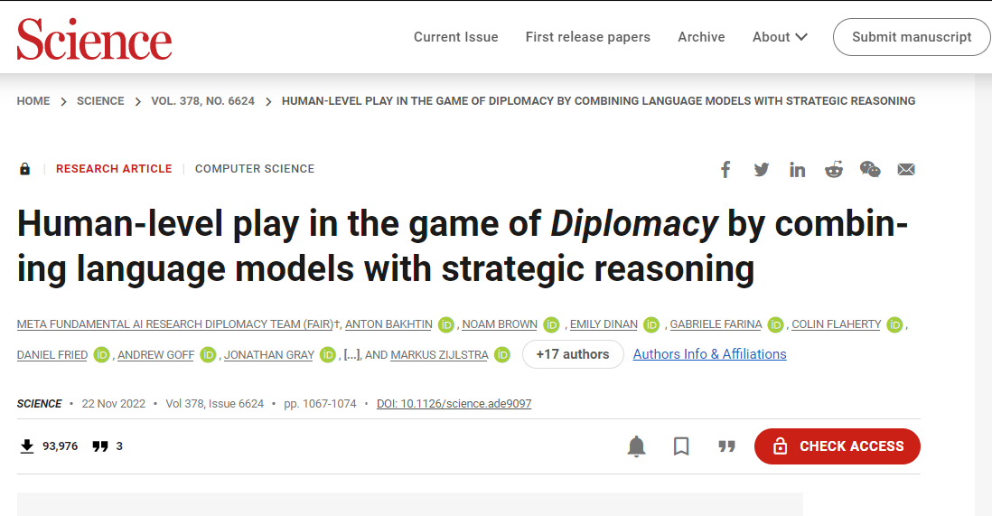
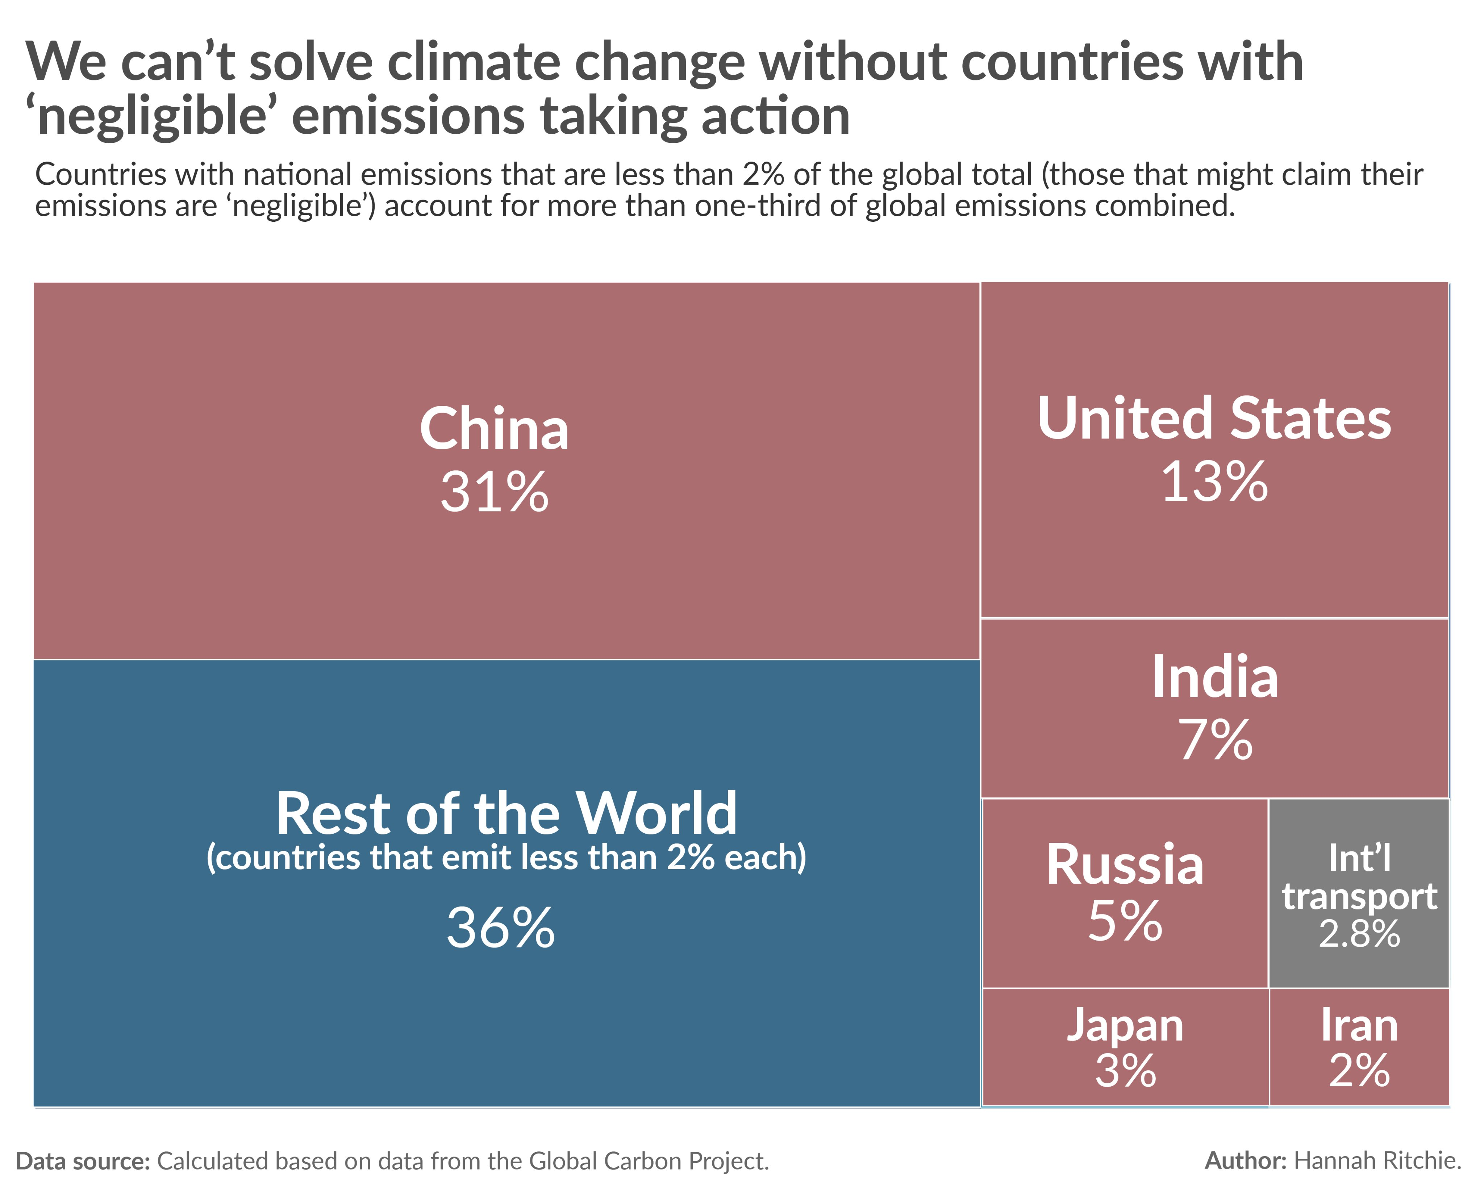
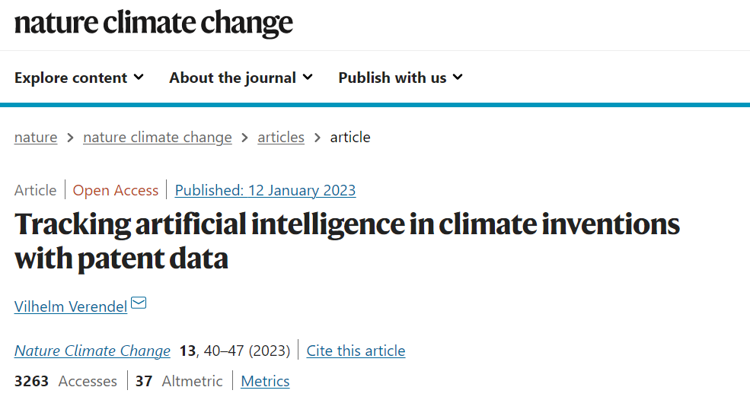
AI for policy
Find novel, optimal and robust sustainable development pathways
Optimize global coordination efforts by using reinforcement learning in climate negotiations
Understand how AI supports climate efforts in innovations
Francesca Larosa, VinuesaLab and KTH Climate Action Centre
Email: larosa@kth.se

Slide 48
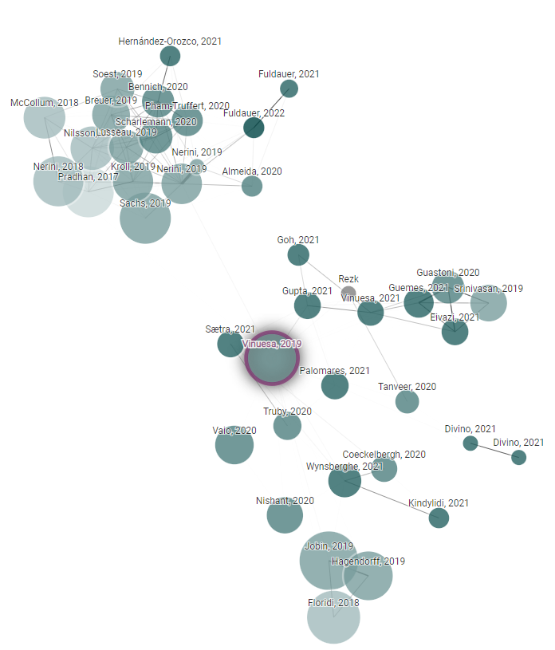
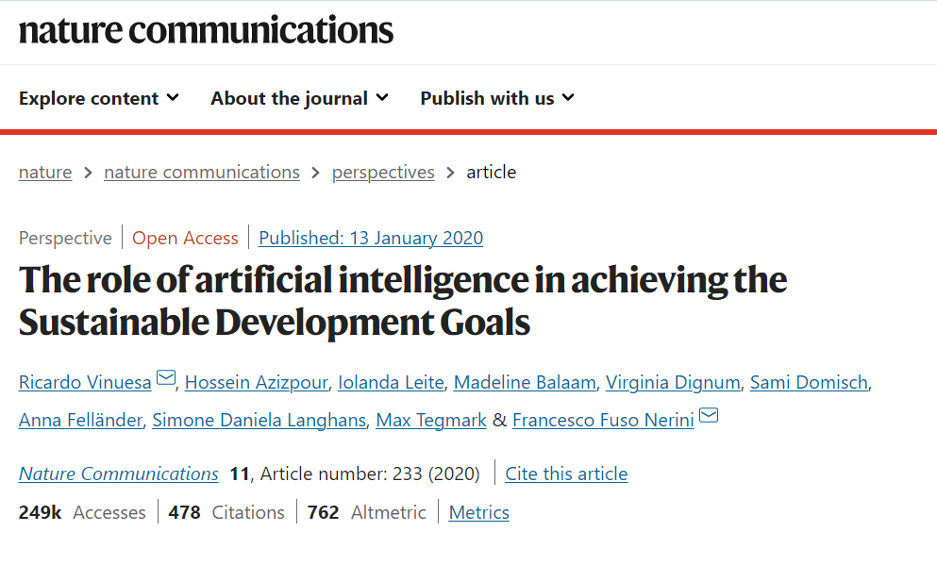
AI as enabler of sustainability goals: obvious?
Source: Vinuesa et al., 2020
Francesca Larosa, VinuesaLab and KTH Climate Action Centre
Email: larosa@kth.se

Slide 49

Can we use LLMs instead of experts?
AI-methods can be used to revolutionize the study of SDG interlinkages
Goal: automatically identifying synergies and trade-offs among the SDGs using to promising areas in AI: natural-language processing (NLP) and deep learning (DL)
A first application will look at the existing synergies and trade-offs between climate action and the SDG targets.
The ultimate goals of the project will be the creation of a tool available for policy makers and project developers
Source: Fuso Nerini et al., 2019
Francesca Larosa, VinuesaLab and KTH Climate Action Centre
Email: larosa@kth.se

Slide 50

DESPITE ALL THESE PROMISES
Francesca Larosa, VinuesaLab and KTH Climate Action Centre
Email: larosa@kth.se

Slide 51

DESPITE ALL THESE PROMISES
Francesca Larosa, VinuesaLab and KTH Climate Action Centre
Email: larosa@kth.se

Slide 52

More to come.
Francesca Larosa, VinuesaLab and KTH Climate Action Centre
Email: larosa@kth.se

Slide 53

Thank you
larosa@kth.se
@FrancescaLaros1

